Slide 1
Previously…

Slide 2
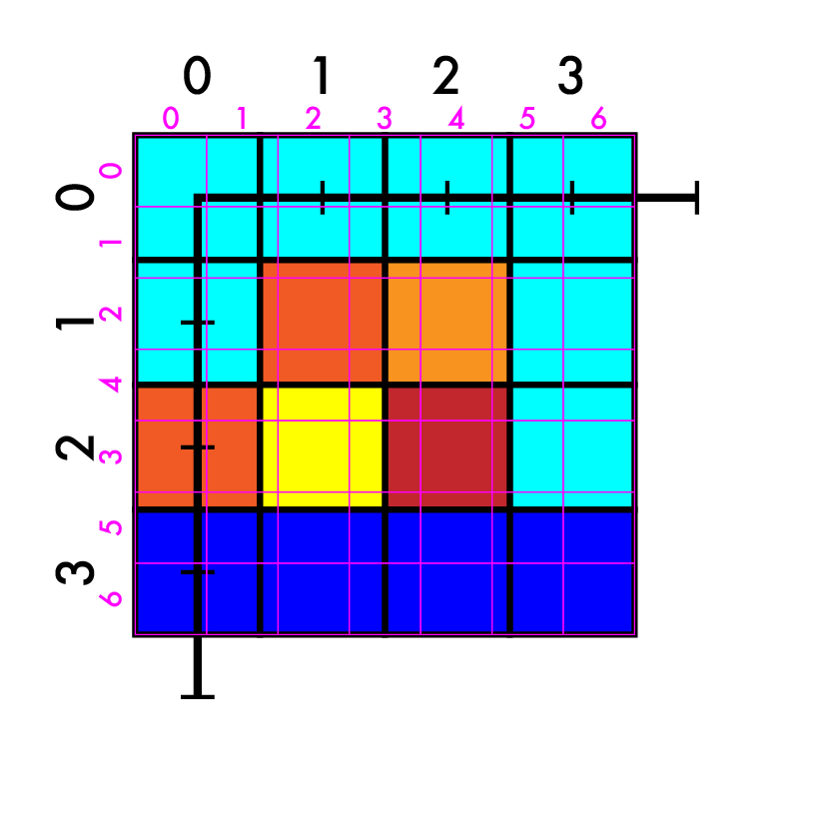
Resize 4x4 -> 7x7
Create our new image
Match up coordinates

Slide 3
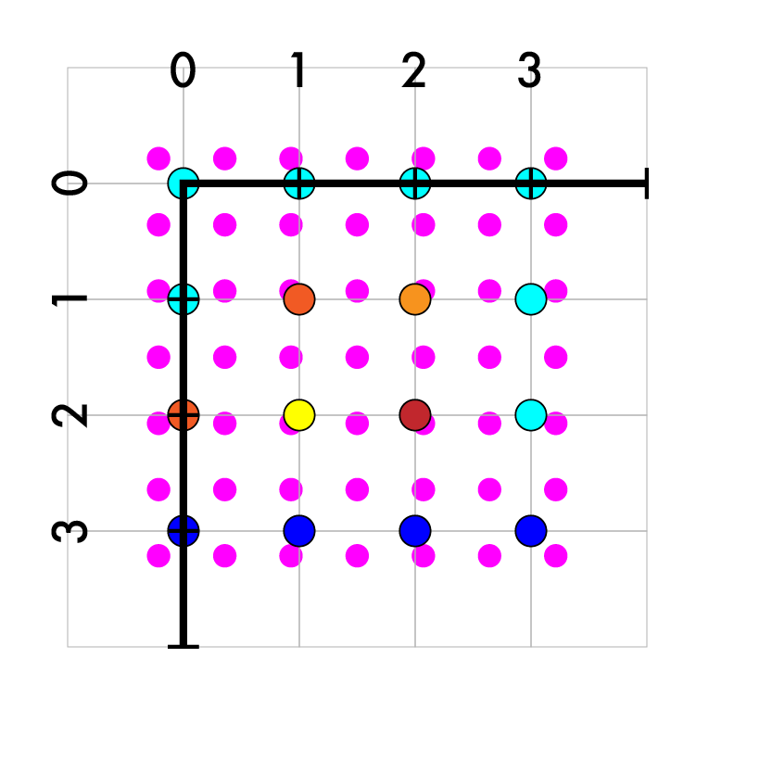
Resize 4x4 -> 7x7
Create our new image
Match up coordinates
4/7 X - 3/14 = Y
Iterate over new pts
Map to old coords

Slide 4
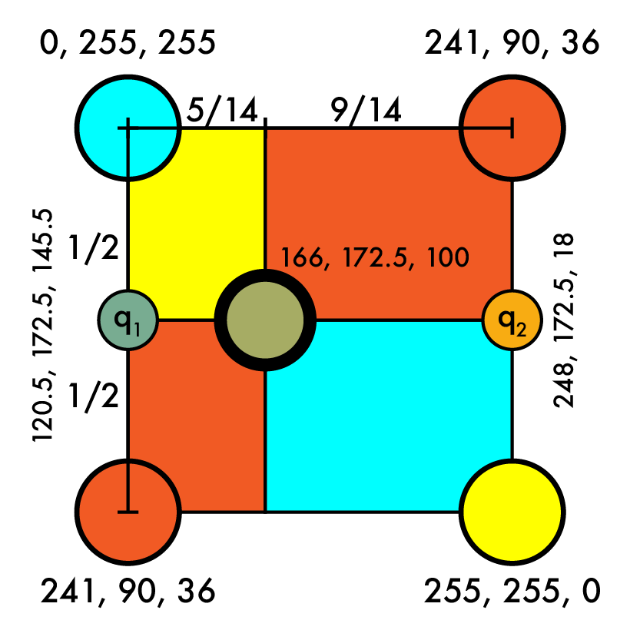
Resize 4x4 -> 7x7
Create our new image
Match up coordinates
4/7 X - 3/14 = Y
Iterate over new pts
Map to old coords
(1, 3) -> (5/14, 7/14)
Interpolate old values
q = (166, 172.5, 100)

Slide 5
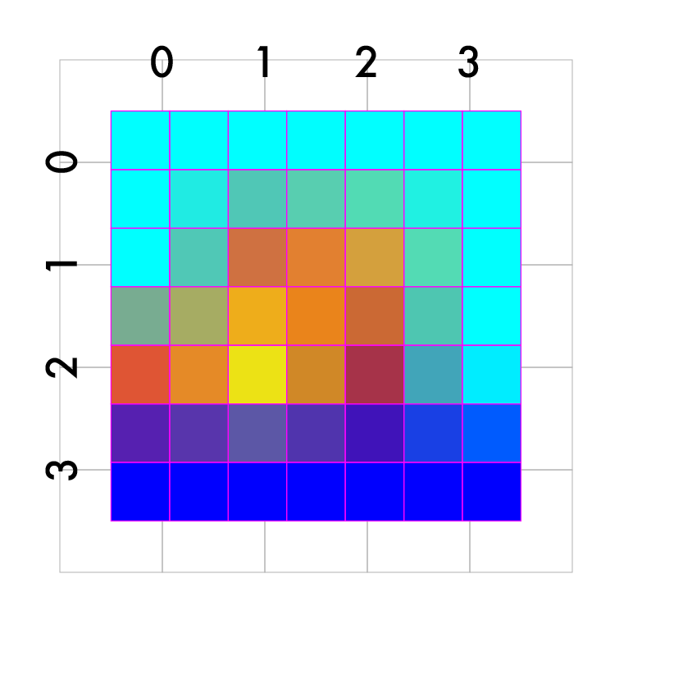
Resize 4x4 -> 7x7
Create our new image
Match up coordinates
4/7 X - 3/14 = Y
Iterate over new pts
Map to old coords
(1, 3) -> (5/14, 7/14)
Interpolate old values
q = (166, 172.5, 100)
Fill in the rest

Slide 6
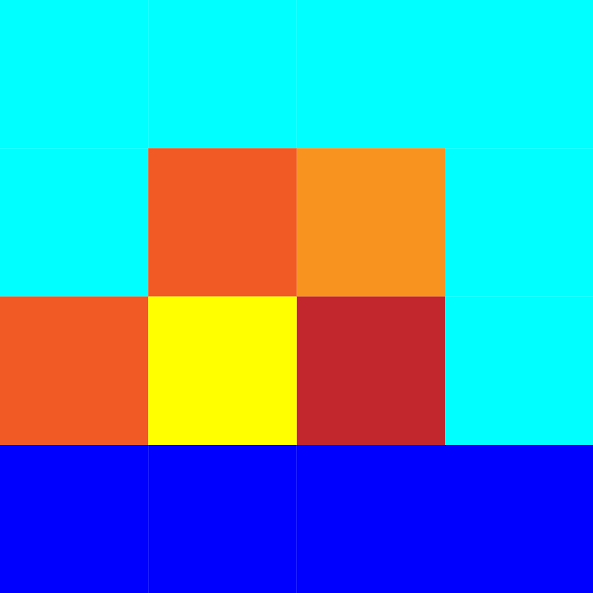
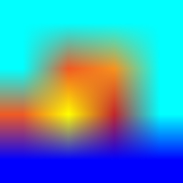


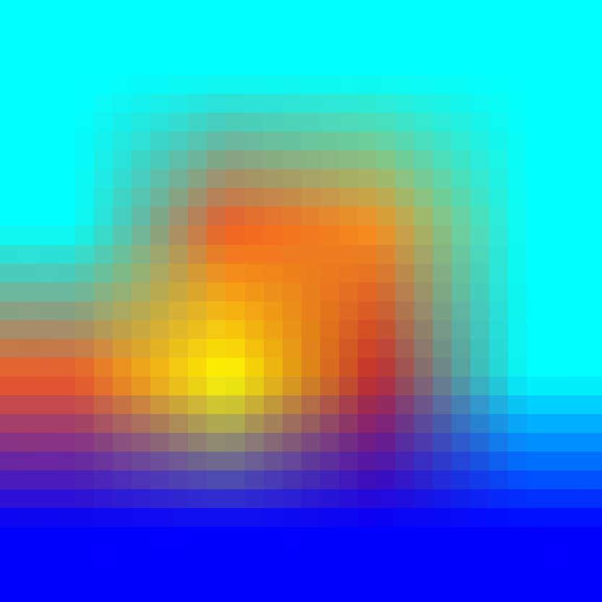

Different methods

Slide 7
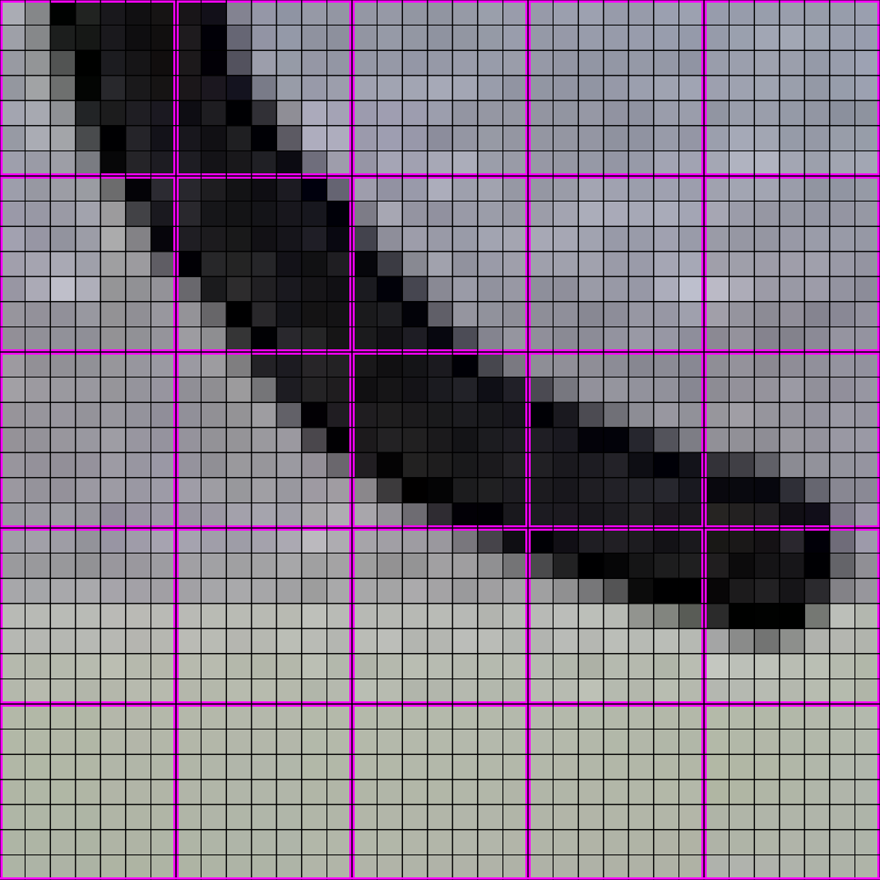

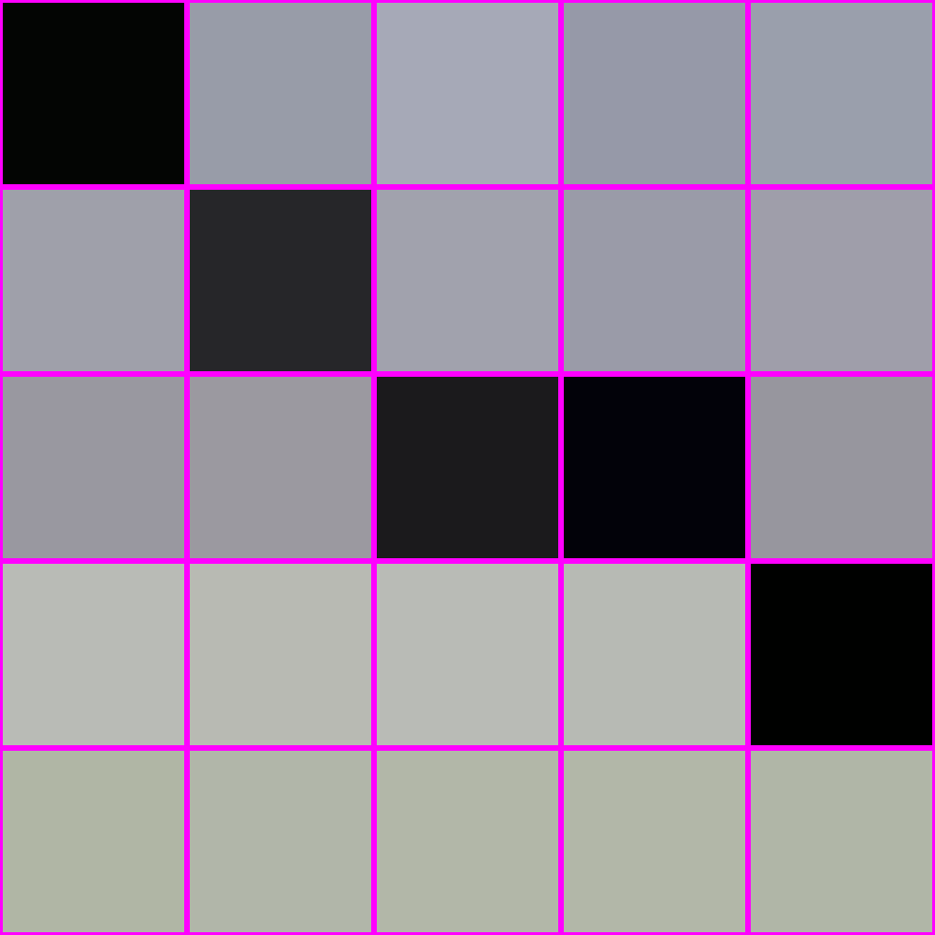
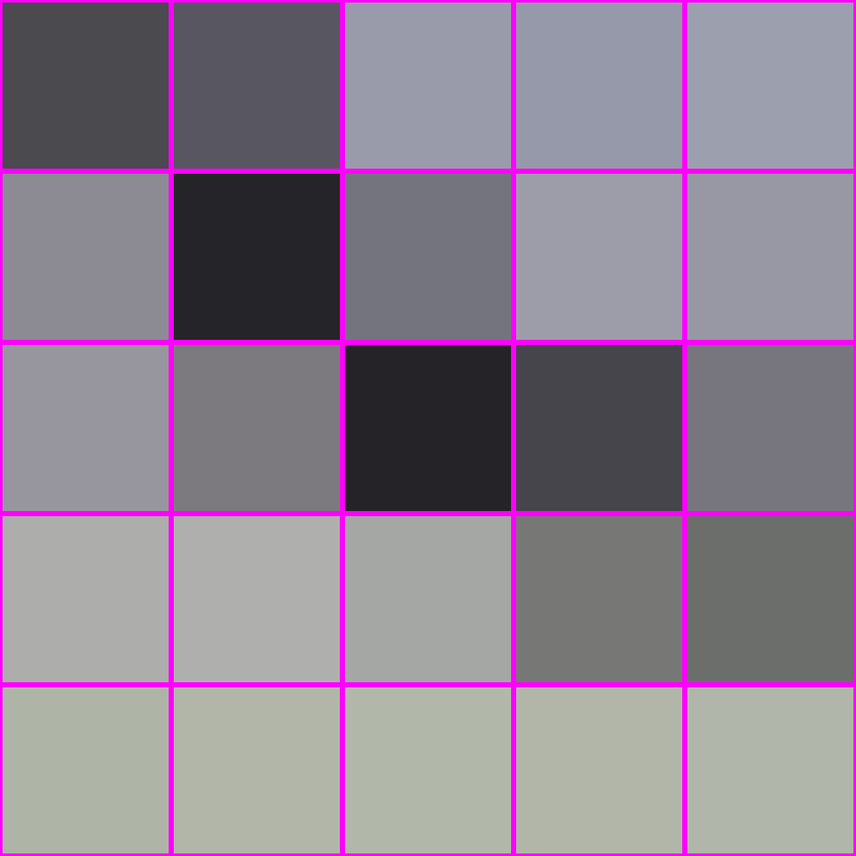
For shrinking interpolation bad, averaging good
“interpolation”
averaging
X

Slide 8
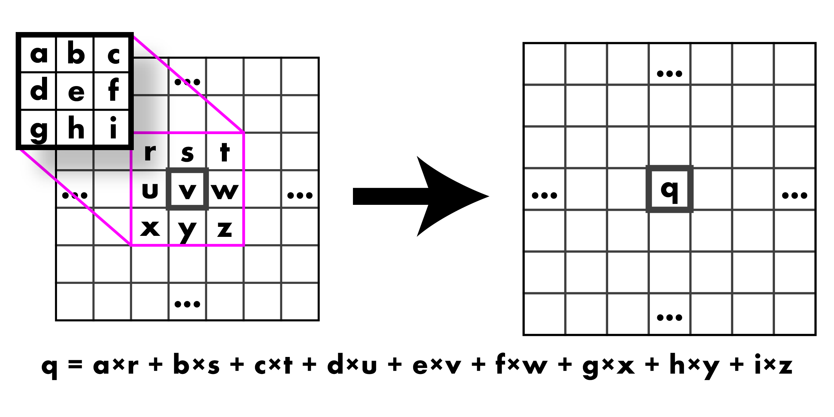
Convolution: Weighted sum over pixels

Slide 9
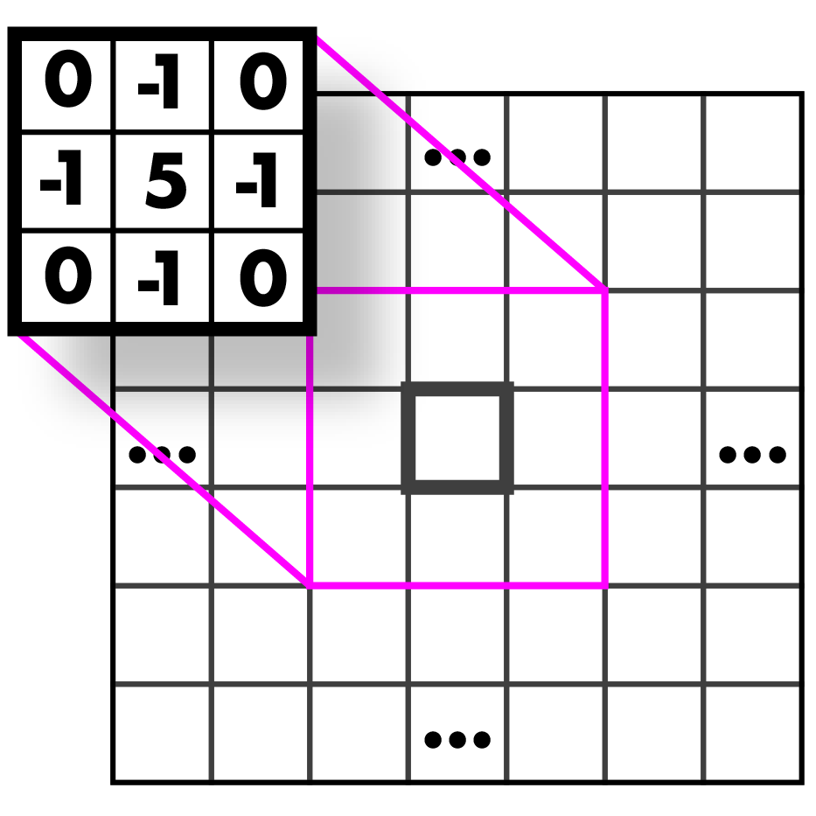
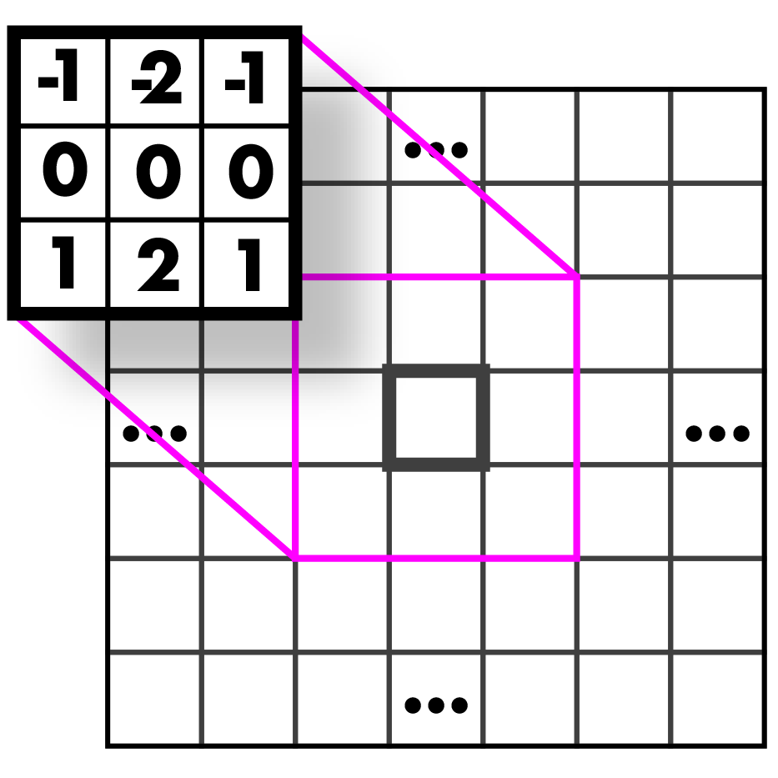
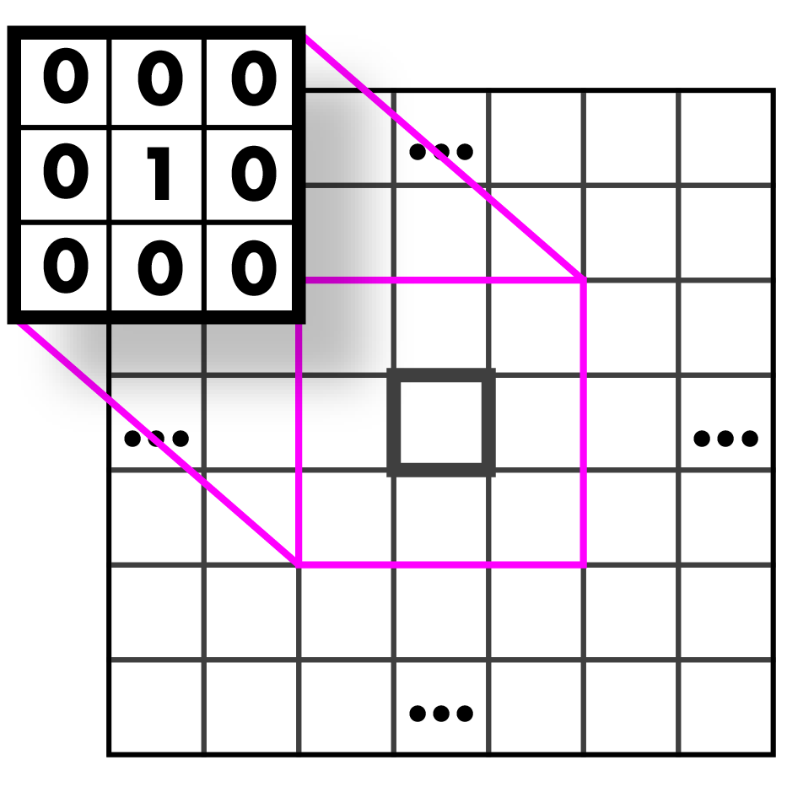



Filters

Slide 10
Moving On…
Edges and Features

Slide 11
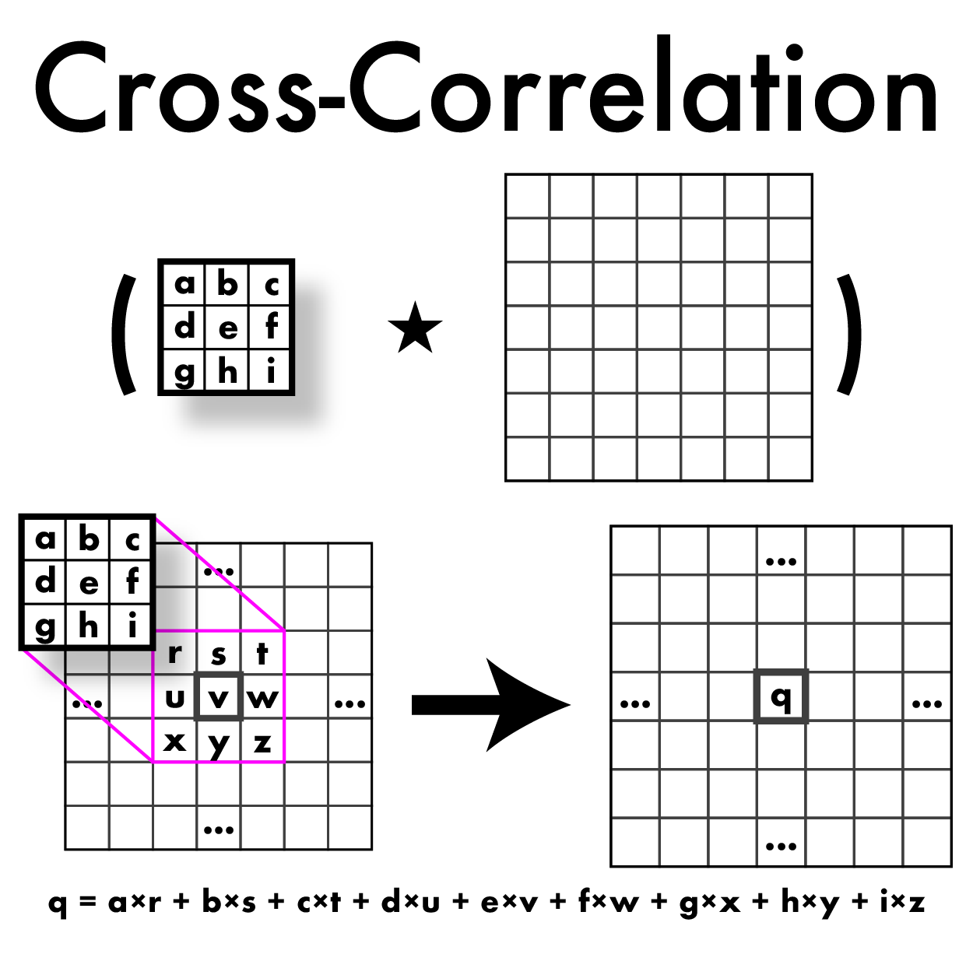
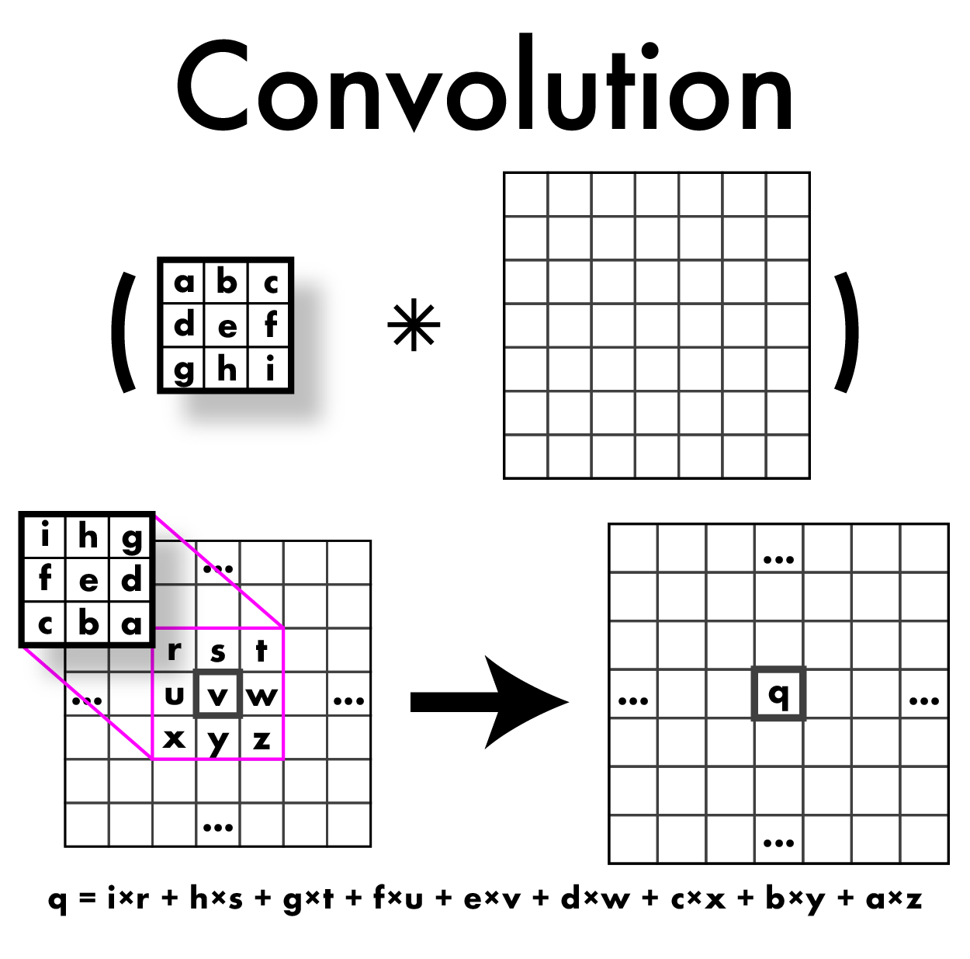
Cross-Correlation vs Convolution

Slide 12
Cross-Correlation vs Convolution
Do this in HW!

Slide 13
Cross-Correlation vs Convolution
These are nicer mathematically

Slide 14
So what can we do with these convolutions anyway?
Mathematically: all the nice things
Commutative
A*B = B*A
Associative
A*(B*C) = (A*B)*C
Distributes over addition
A*(B+C) = A*B + A*C
Plays well with scalars
x(A*B) = (xA)*B = A*(xB)

Slide 15
So what can we do with these convolutions anyway?
This means some convolutions decompose:
2d gaussian is just composition of 1d gaussians
Faster to run 2 1d convolutions

Slide 16
So what can we do with these convolutions anyway?
Blurring
Sharpening
Edges
Features
Derivatives
Super-resolution
Classification
Detection
Image captioning
...

Slide 17
So what can we do with these convolutions anyway?
Blurring
Sharpening
Edges
Features
Derivatives
Super-resolution
Classification
Detection
Image captioning
...
All of computer vision
is convolutions
(basically)

Slide 18
So what can we do with these convolutions anyway?
Blurring
Sharpening
Edges
Features
Derivatives
Super-resolution
Classification
Detection
Image captioning
...
All of computer vision
is convolutions
(basically)

Slide 19
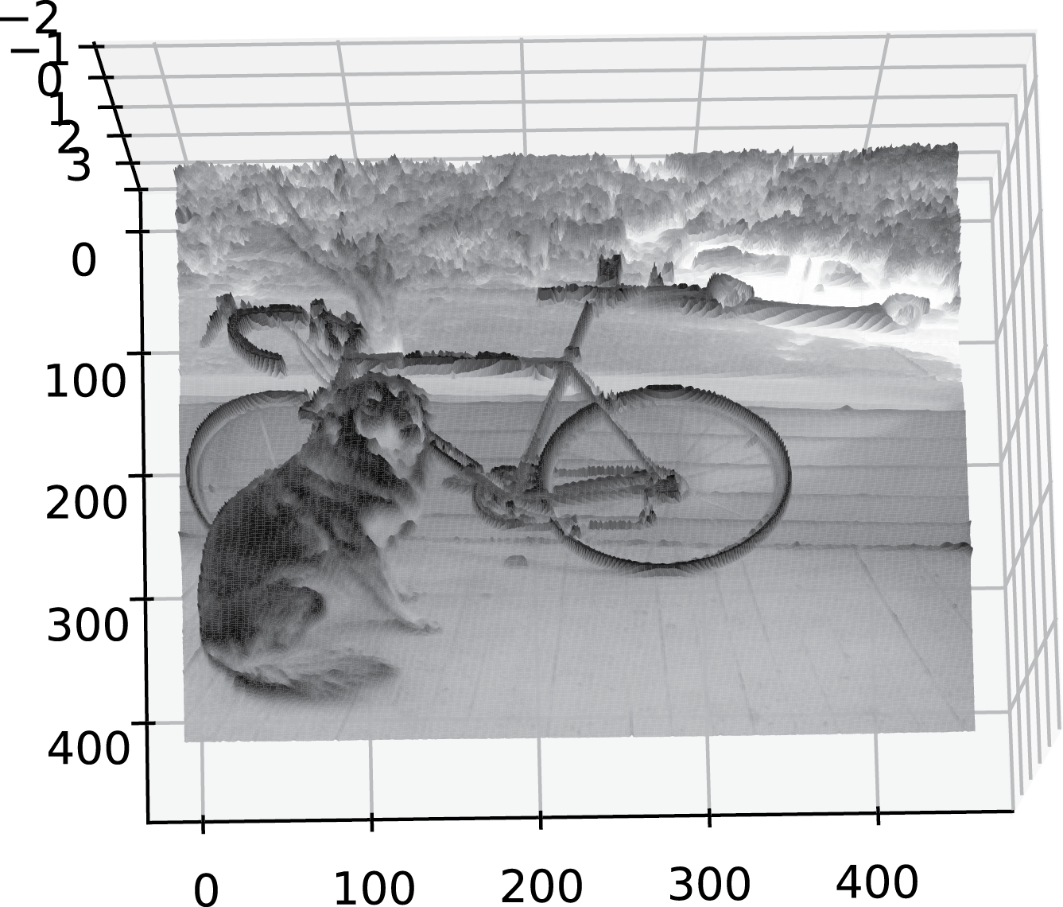
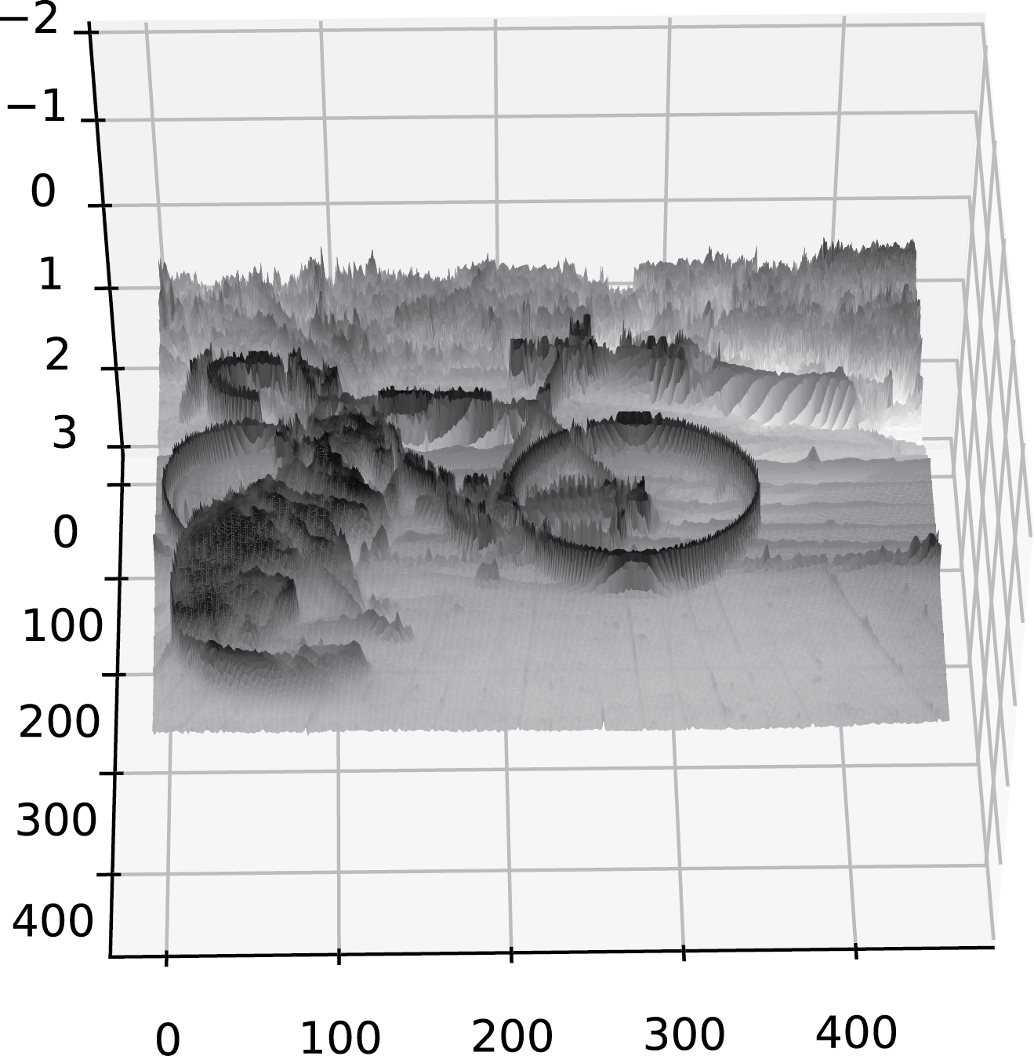
What’s an edge?
Image is a function
Edges are rapid changes in this function

Slide 20
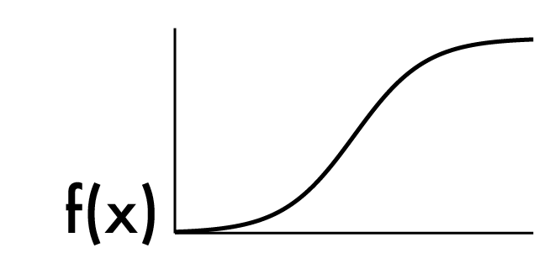
What’s an edge?
Image is a function
Edges are rapid changes in this function

Slide 21
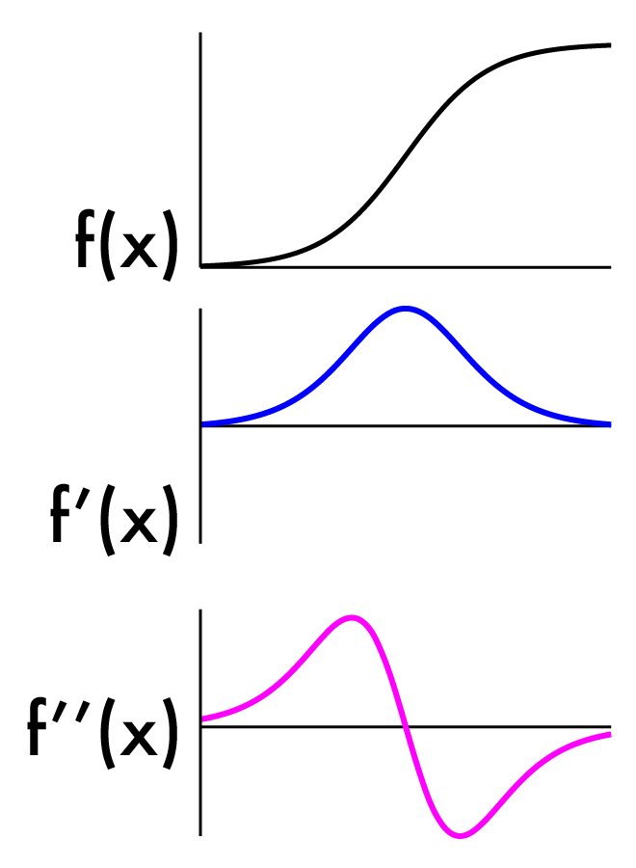
Finding edges
Could take derivative
Edges = high response

Slide 22
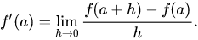
Image derivatives
Recall:
We don’t have an “actual” Function, must estimate
Possibility: set h = 1
What will that look like?

Slide 23
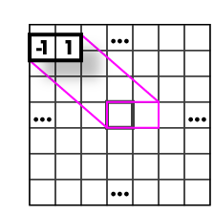
Image derivatives
Recall:
We don’t have an “actual” Function, must estimate
Possibility: set h = 1
What will that look like?

Slide 24
Image derivatives
Recall:
We don’t have an “actual” Function, must estimate
Possibility: set h = 2
What will that look like?

Slide 25
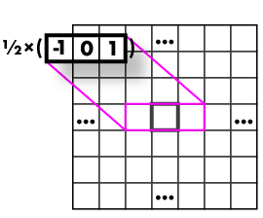
Image derivatives
Recall:
We don’t have an “actual” Function, must estimate
Possibility: set h = 2
What will that look like?

Slide 26
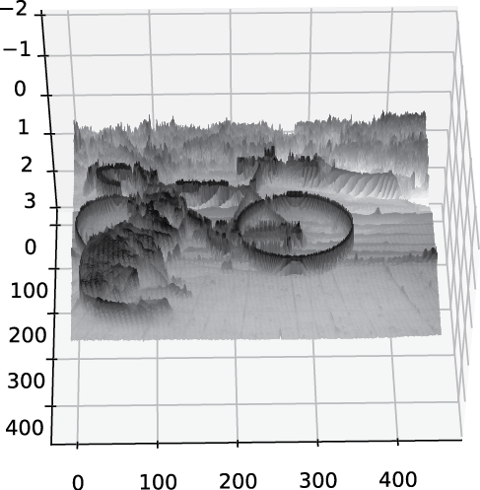
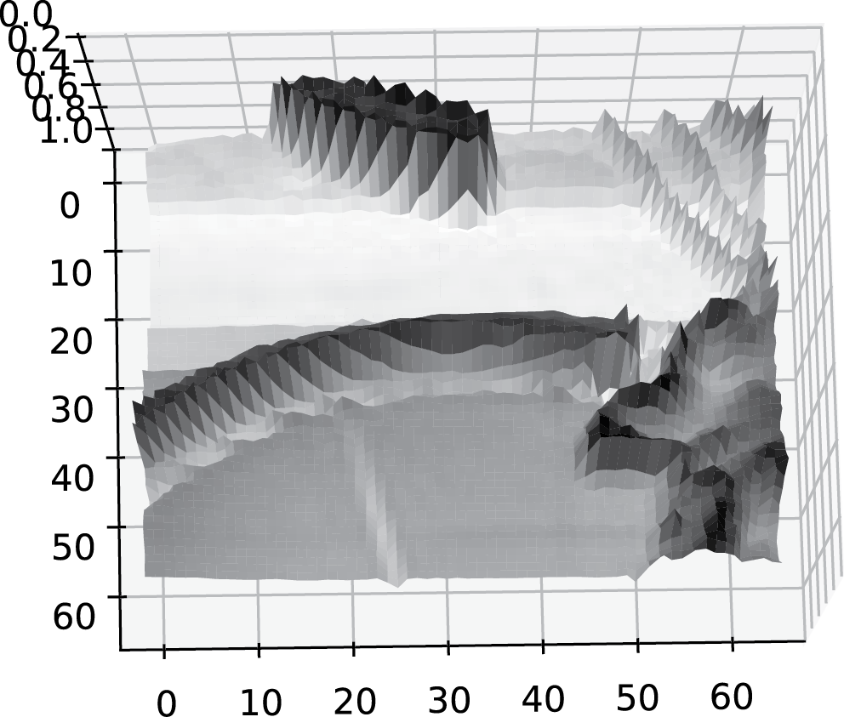
Images are noisy!

Slide 27
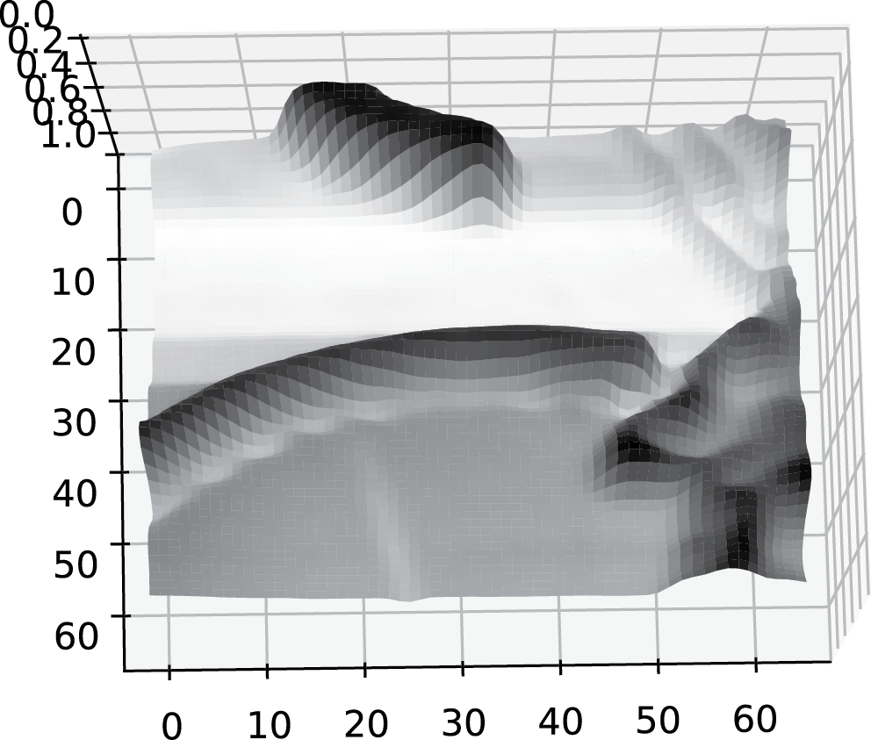
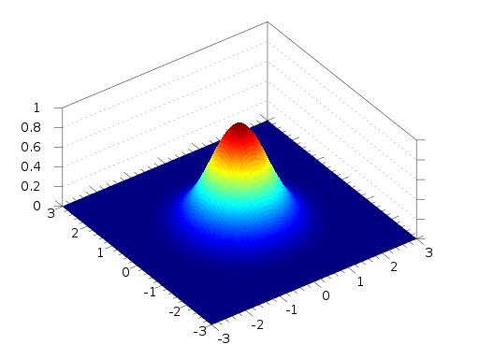
But we already know how to smooth
* =

Slide 28
But we already know how to smooth
* =

Slide 29
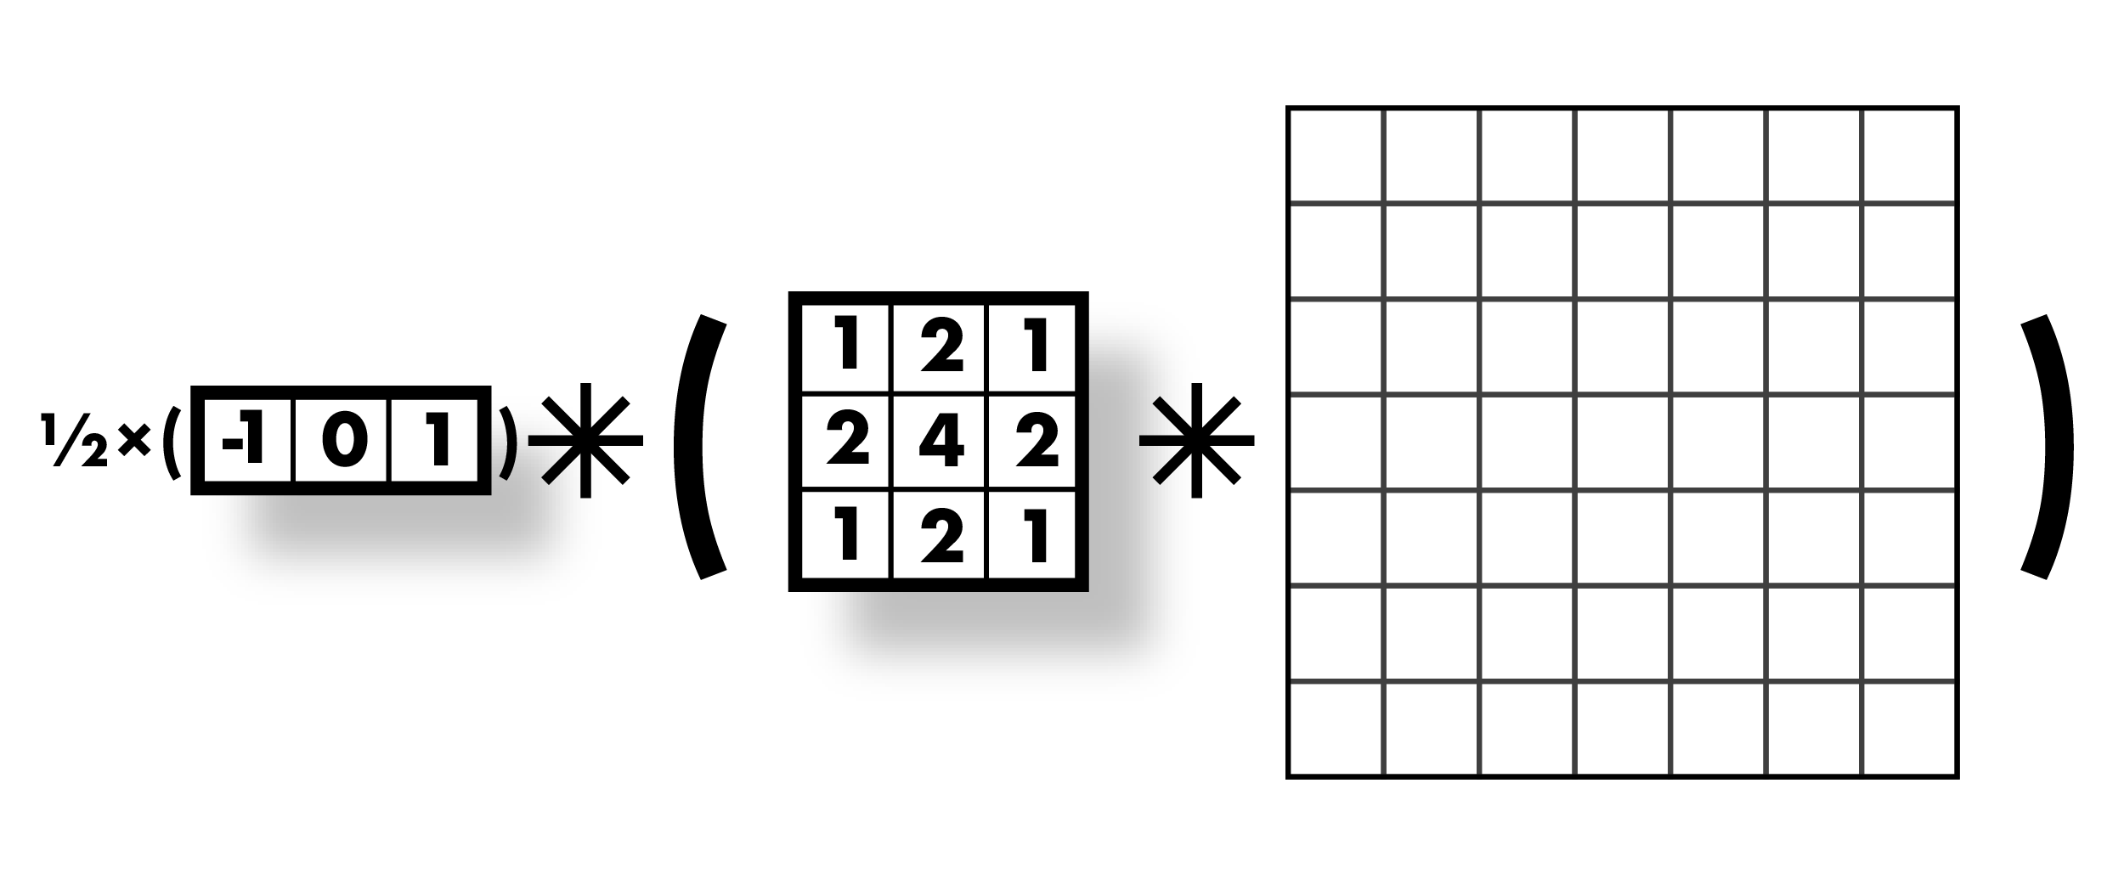
Smooth first, then derivative

Slide 30
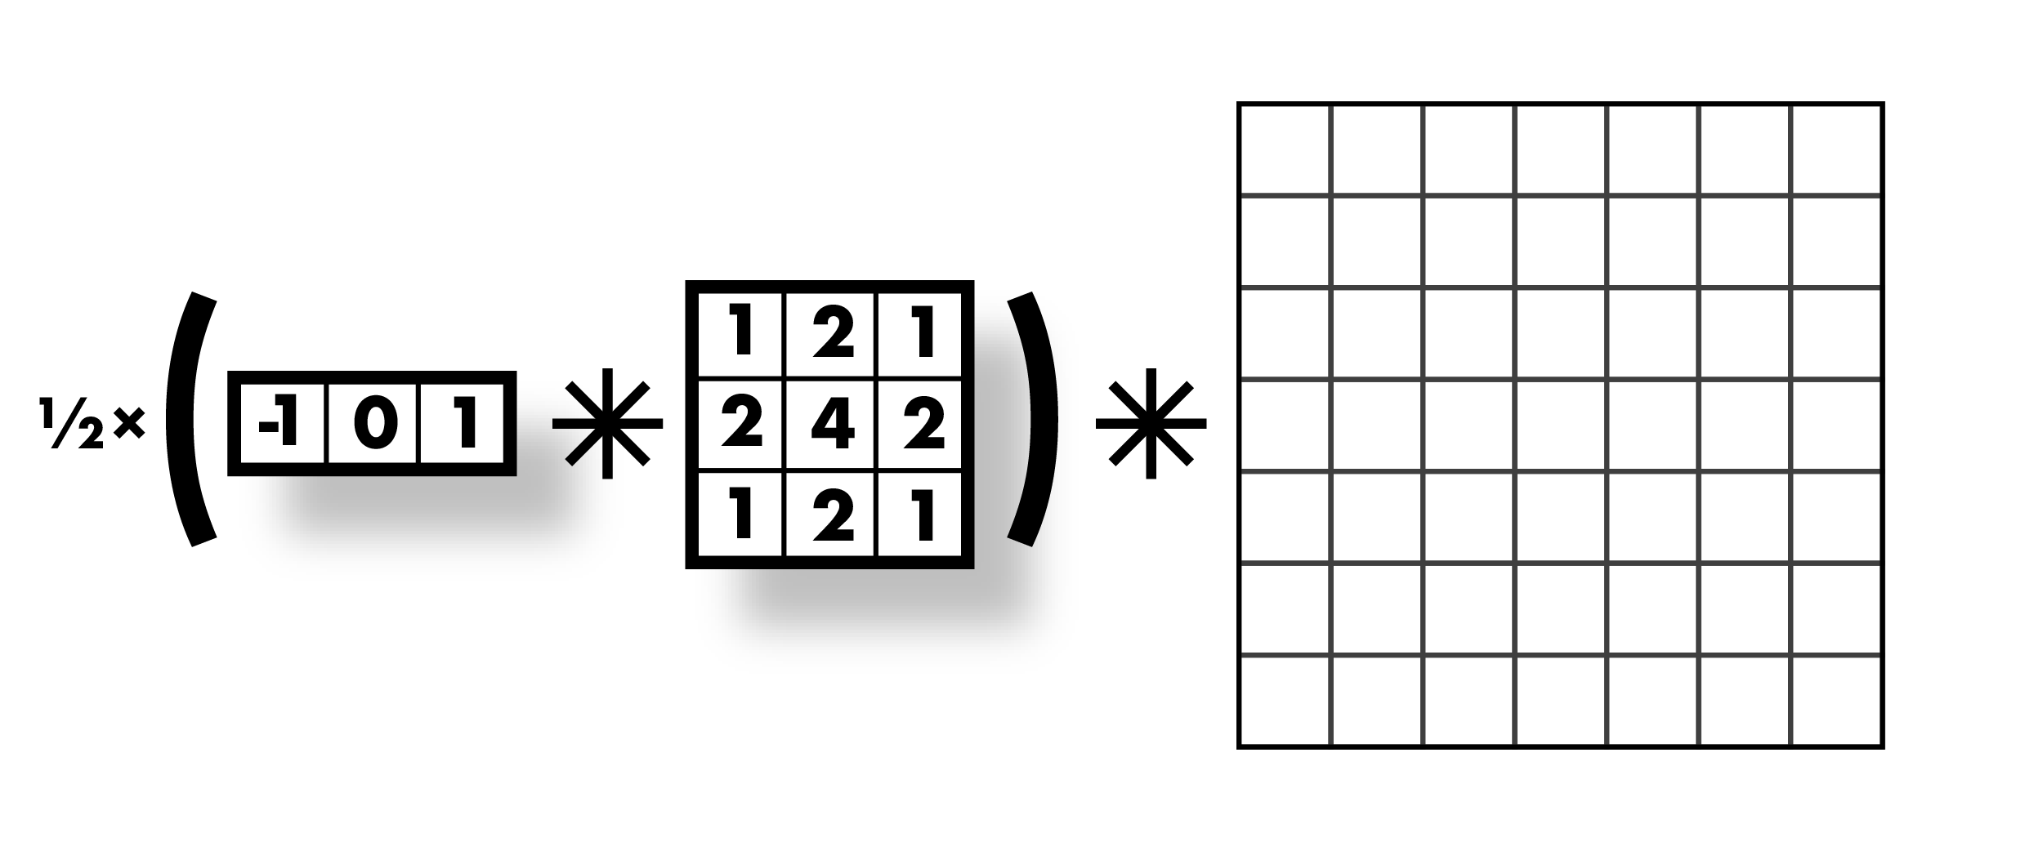
Smooth first, then derivative

Slide 31
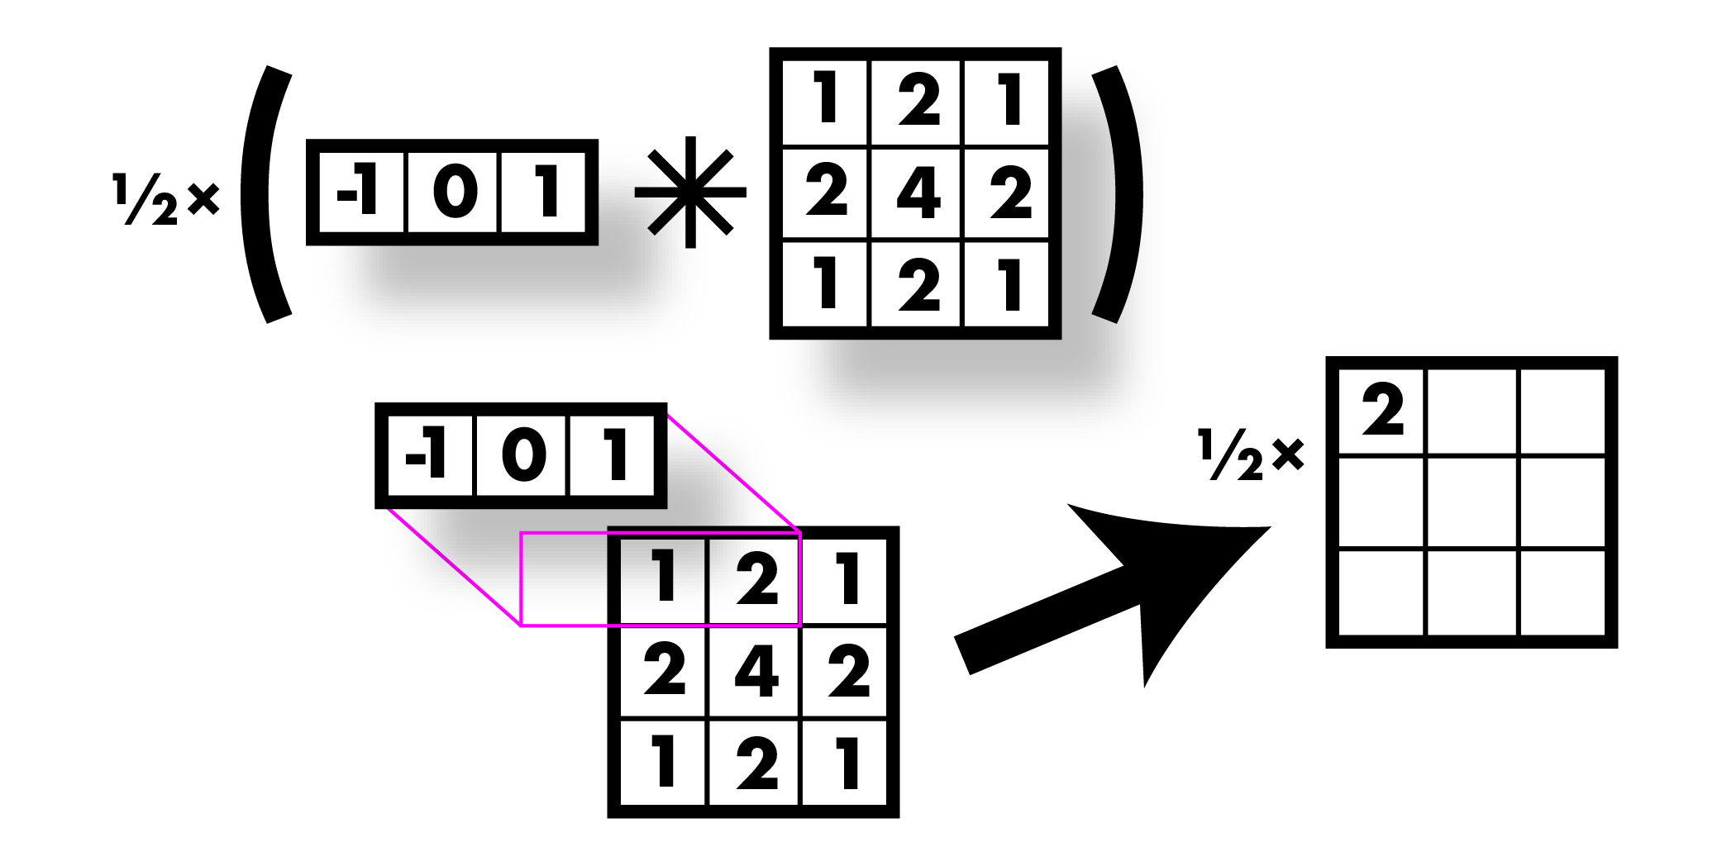
Smooth first, then derivative

Slide 32
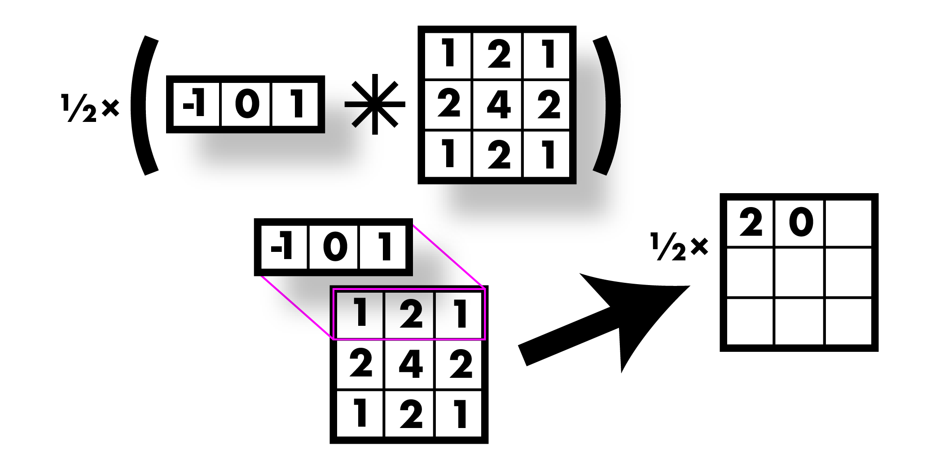
Smooth first, then derivative

Slide 33
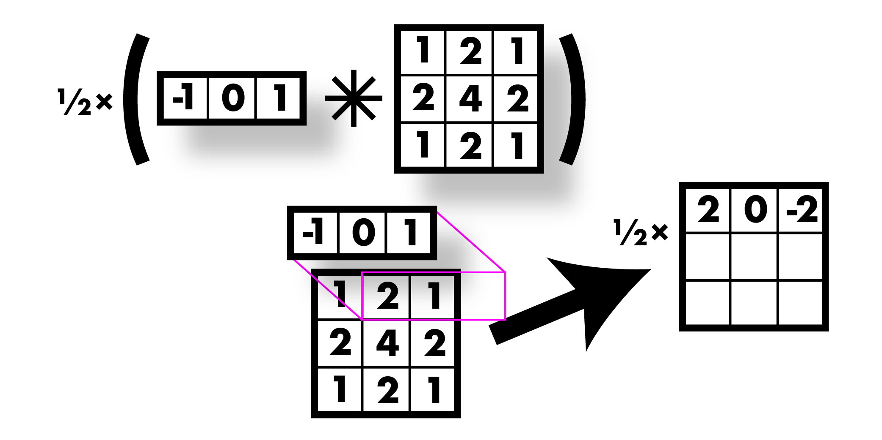
Smooth first, then derivative

Slide 34
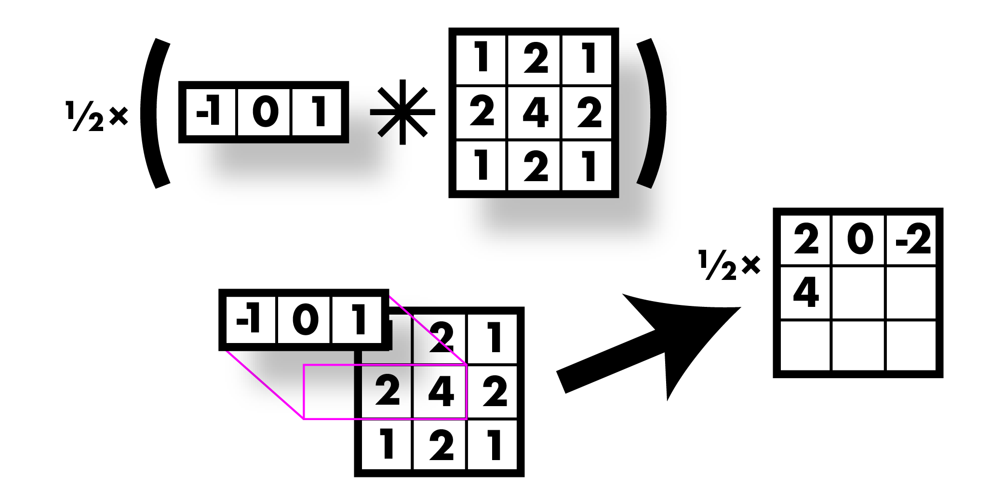
Smooth first, then derivative

Slide 35
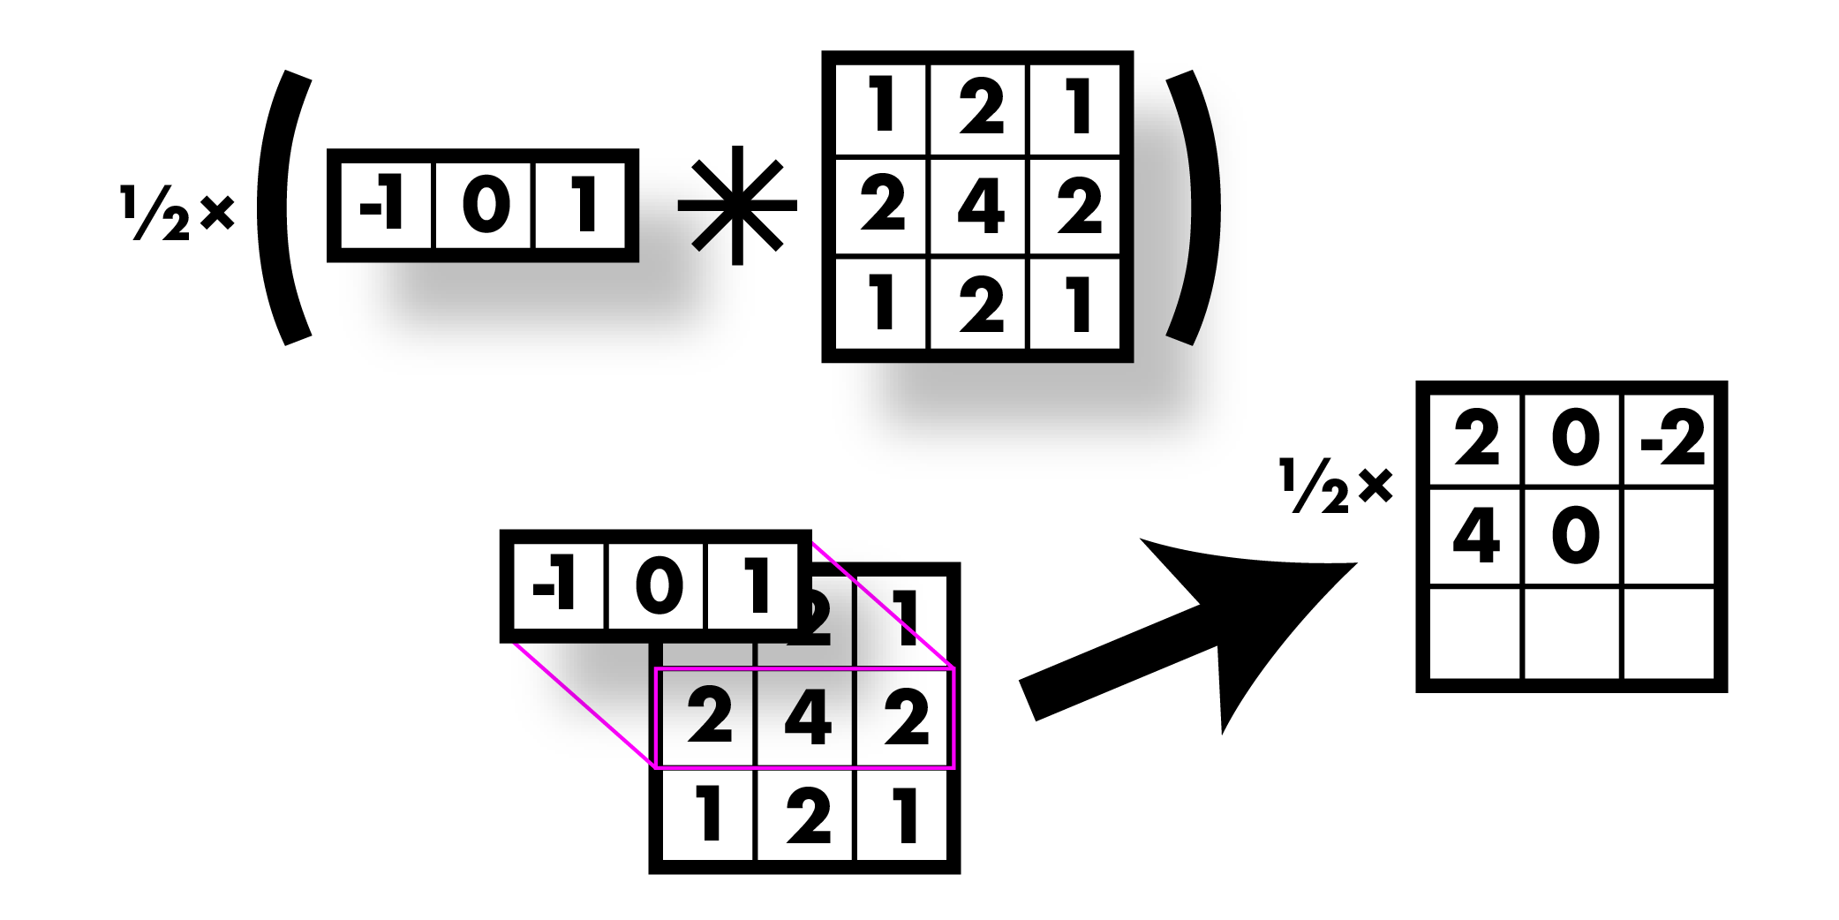
Smooth first, then derivative

Slide 36
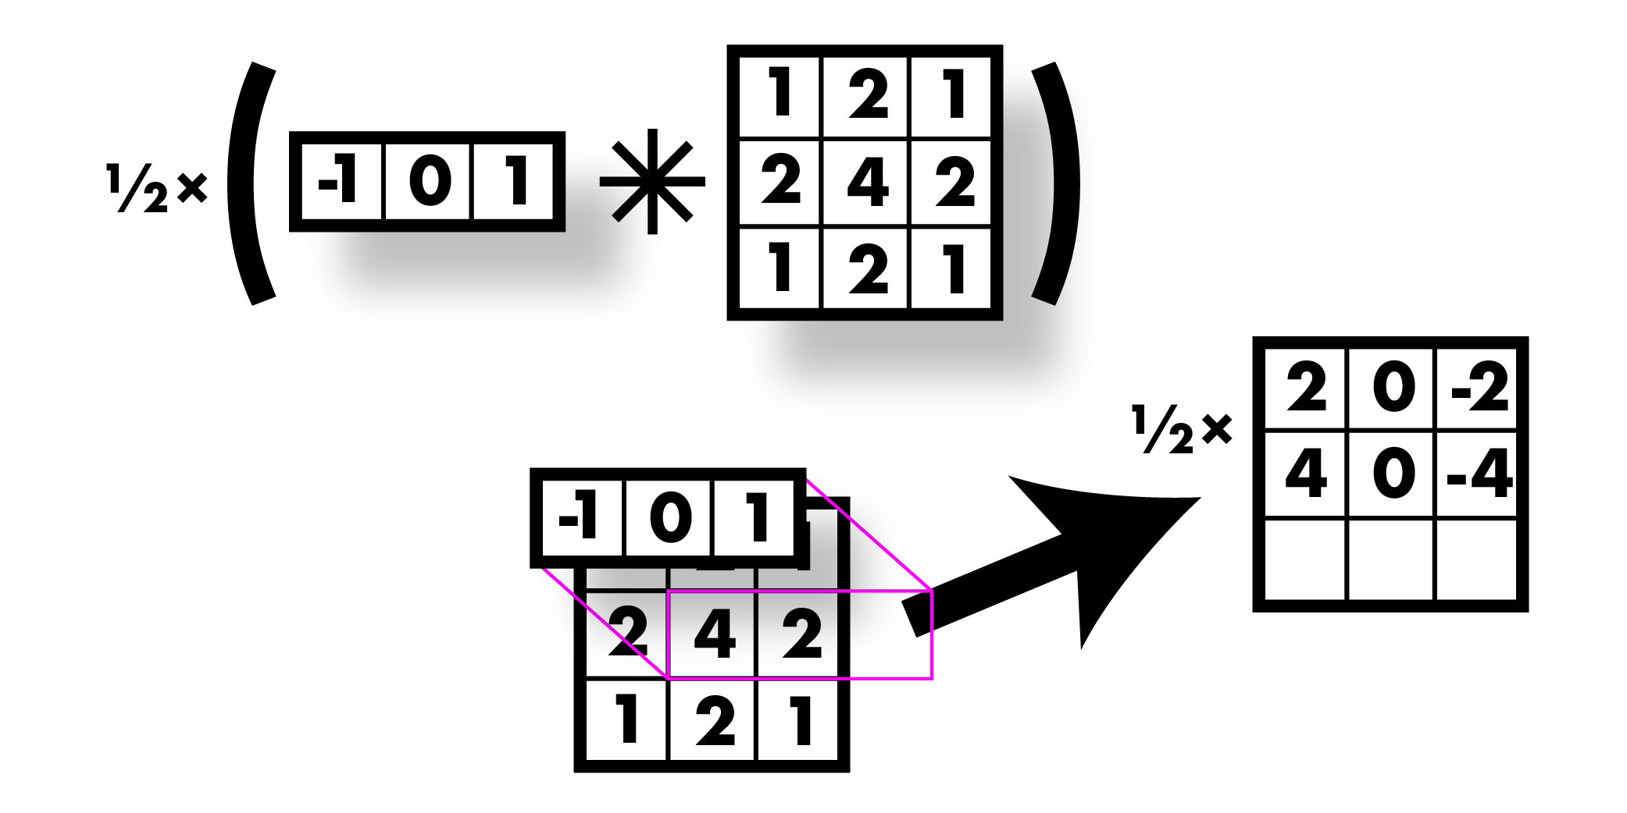
Smooth first, then derivative

Slide 37
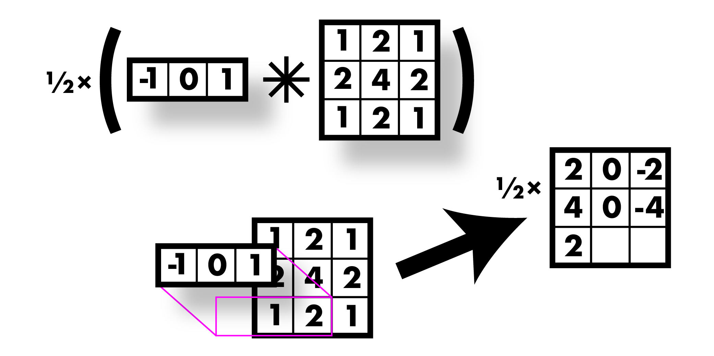
Smooth first, then derivative

Slide 38
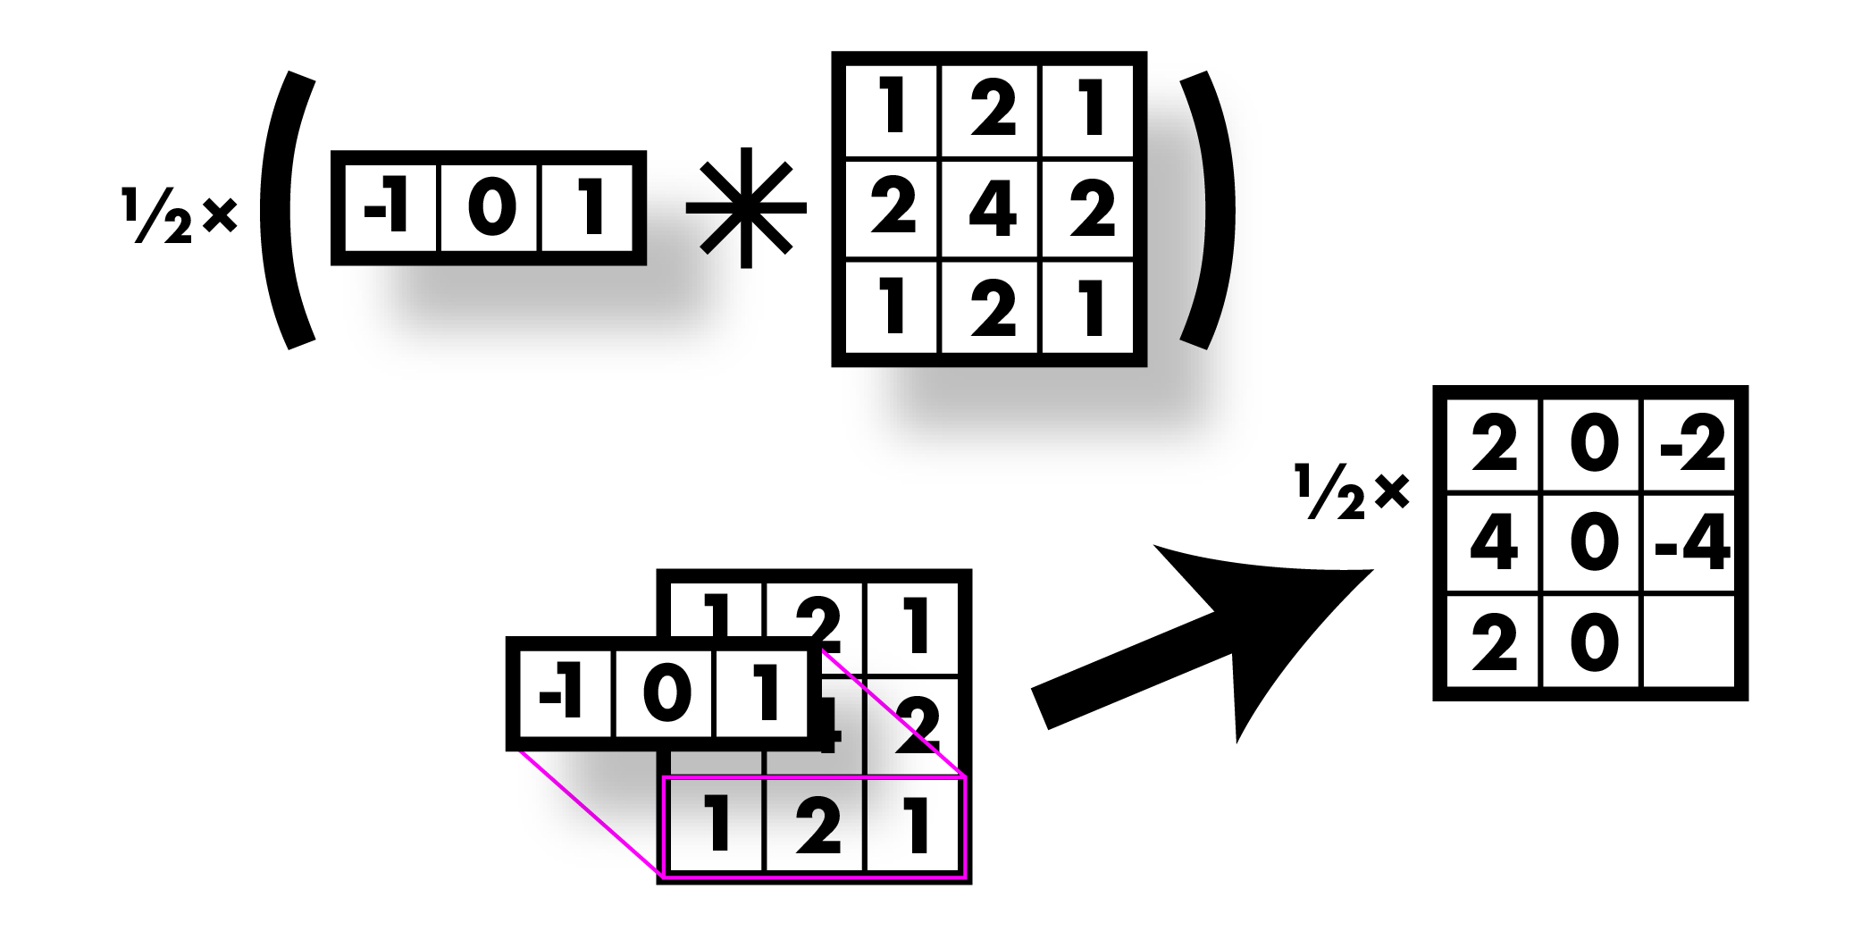
Smooth first, then derivative

Slide 39
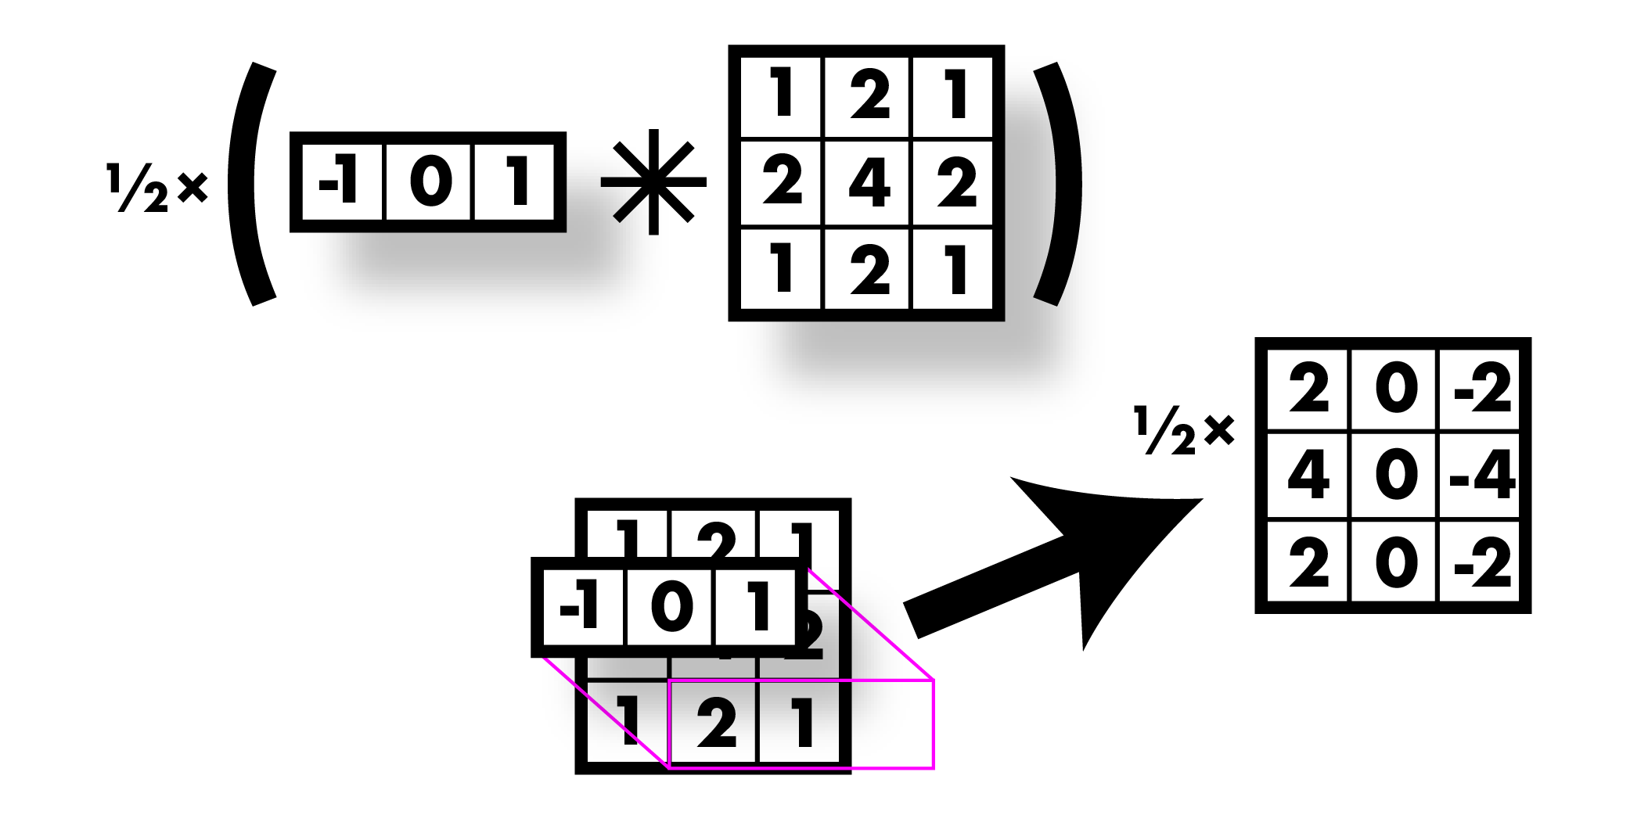
Smooth first, then derivative

Slide 40

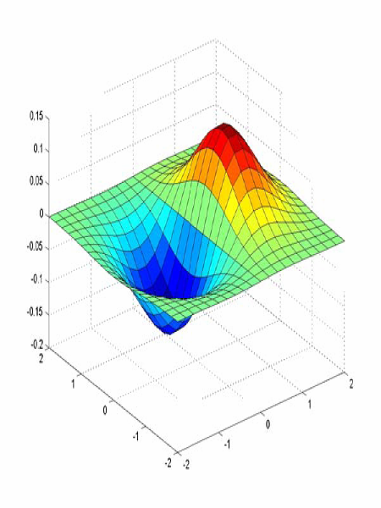
Sobel filter! Smooth & derivative

Slide 41
Image derivatives
Recall:
Want smoothing too!

Slide 42
Finding edges
Could take derivative
Find high responses
Sobel filters!
But…

Slide 43
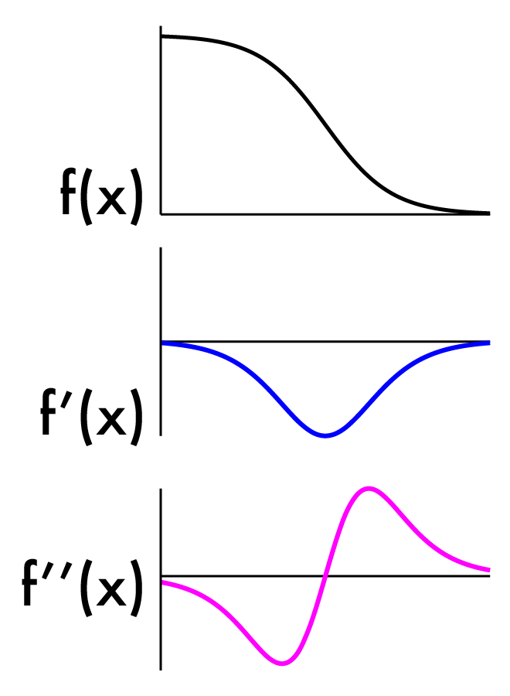
Finding edges
Could take derivative
Find high responses
Sobel filters!
But…
Edges go both ways
Want to find extrema

Slide 44
2nd derivative!
Crosses zero at extrema

Slide 45
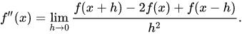
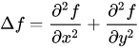
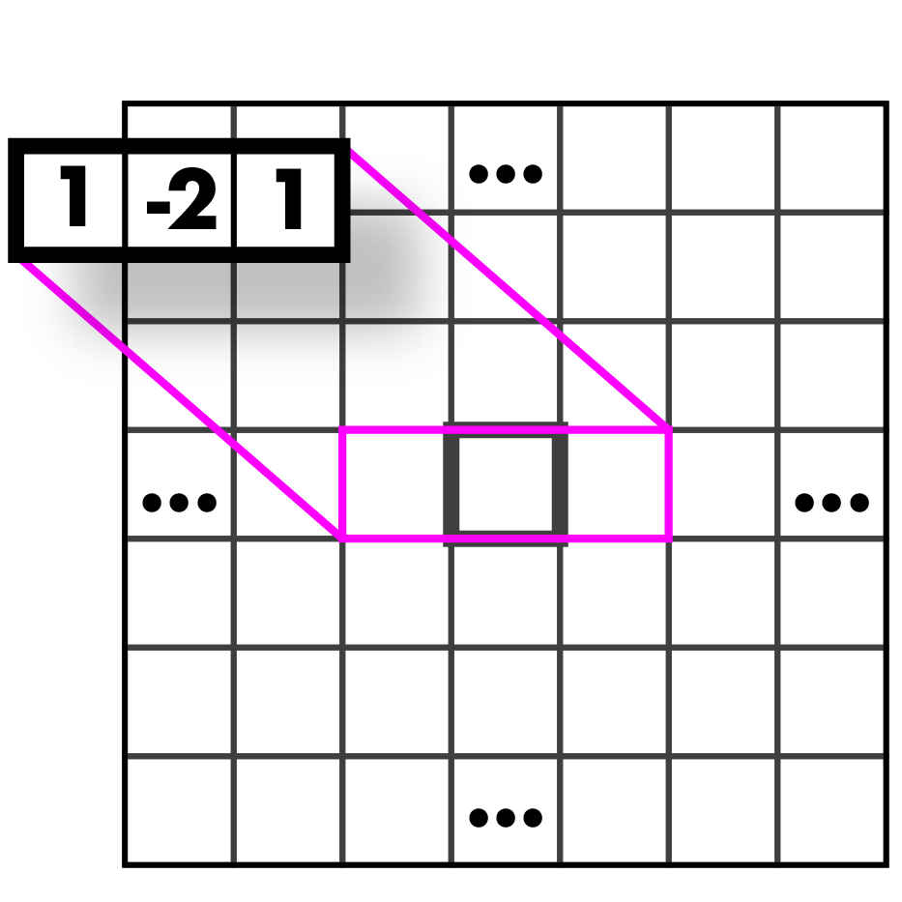
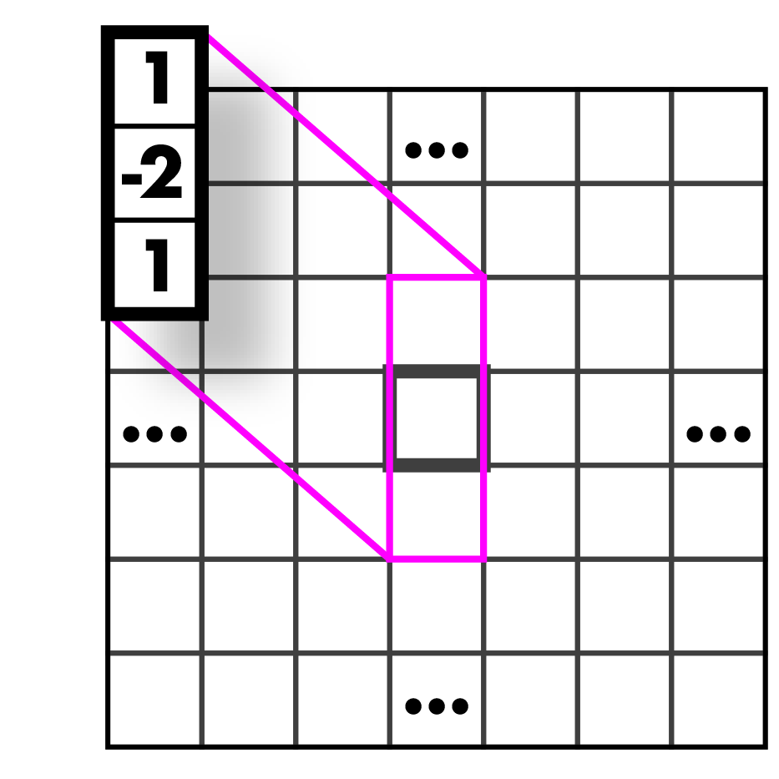
Laplacian (2nd derivative)!
Crosses zero at extrema
Recall:
Laplacian:
Again, have to estimate f’’(x):

Slide 46
Laplacians
Laplacian:

Slide 47
Laplacians
Laplacian:
Measures the divergence of the gradient
Flux of gradient vector field through small area

Slide 48


Slide 49


Slide 50
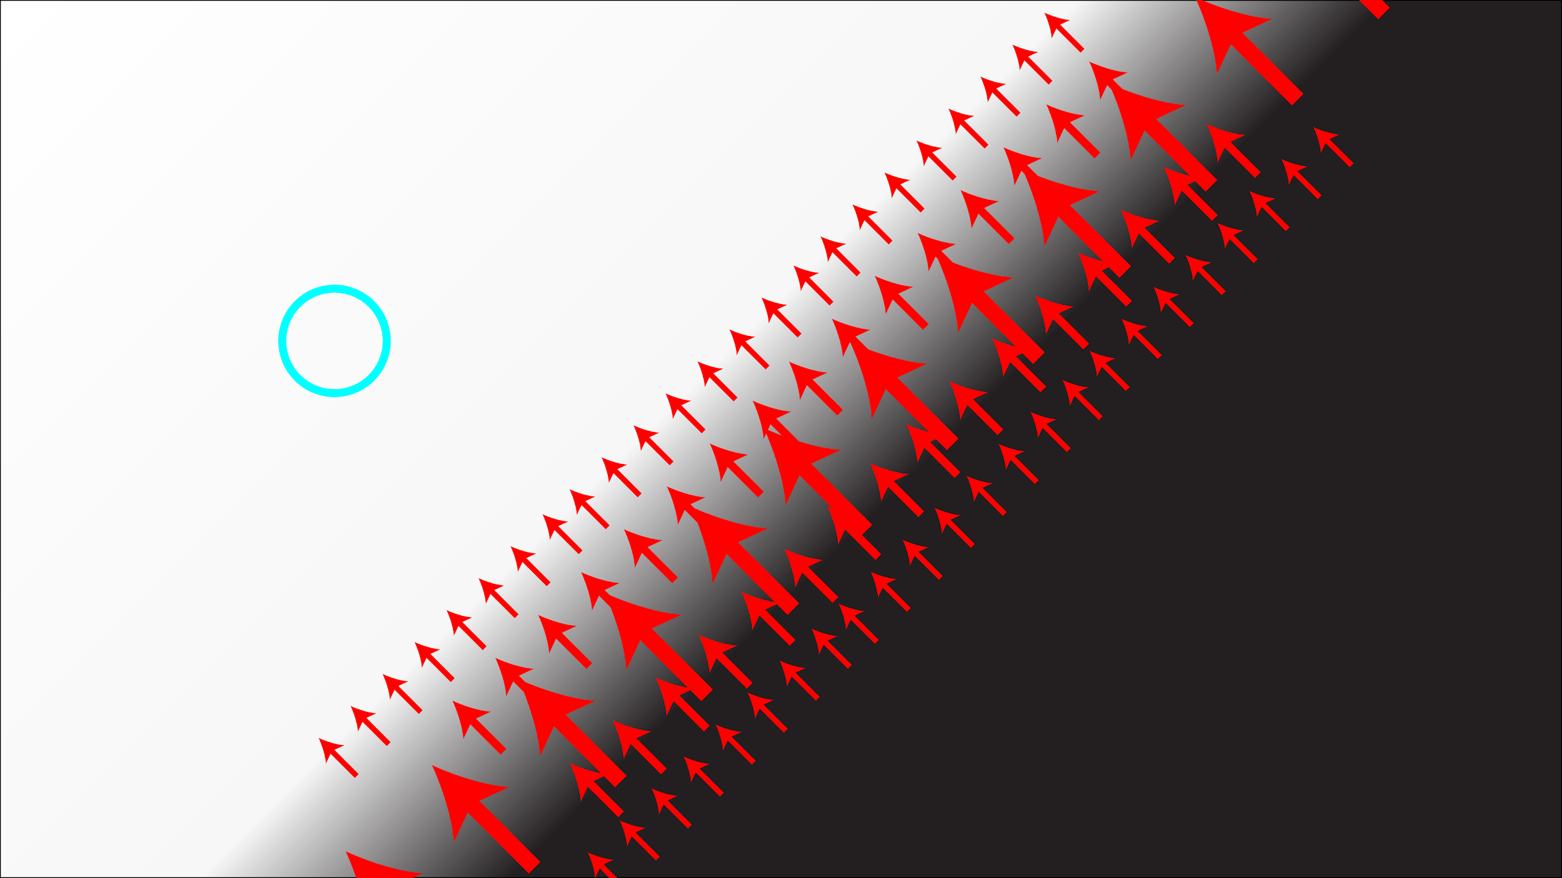

Slide 51
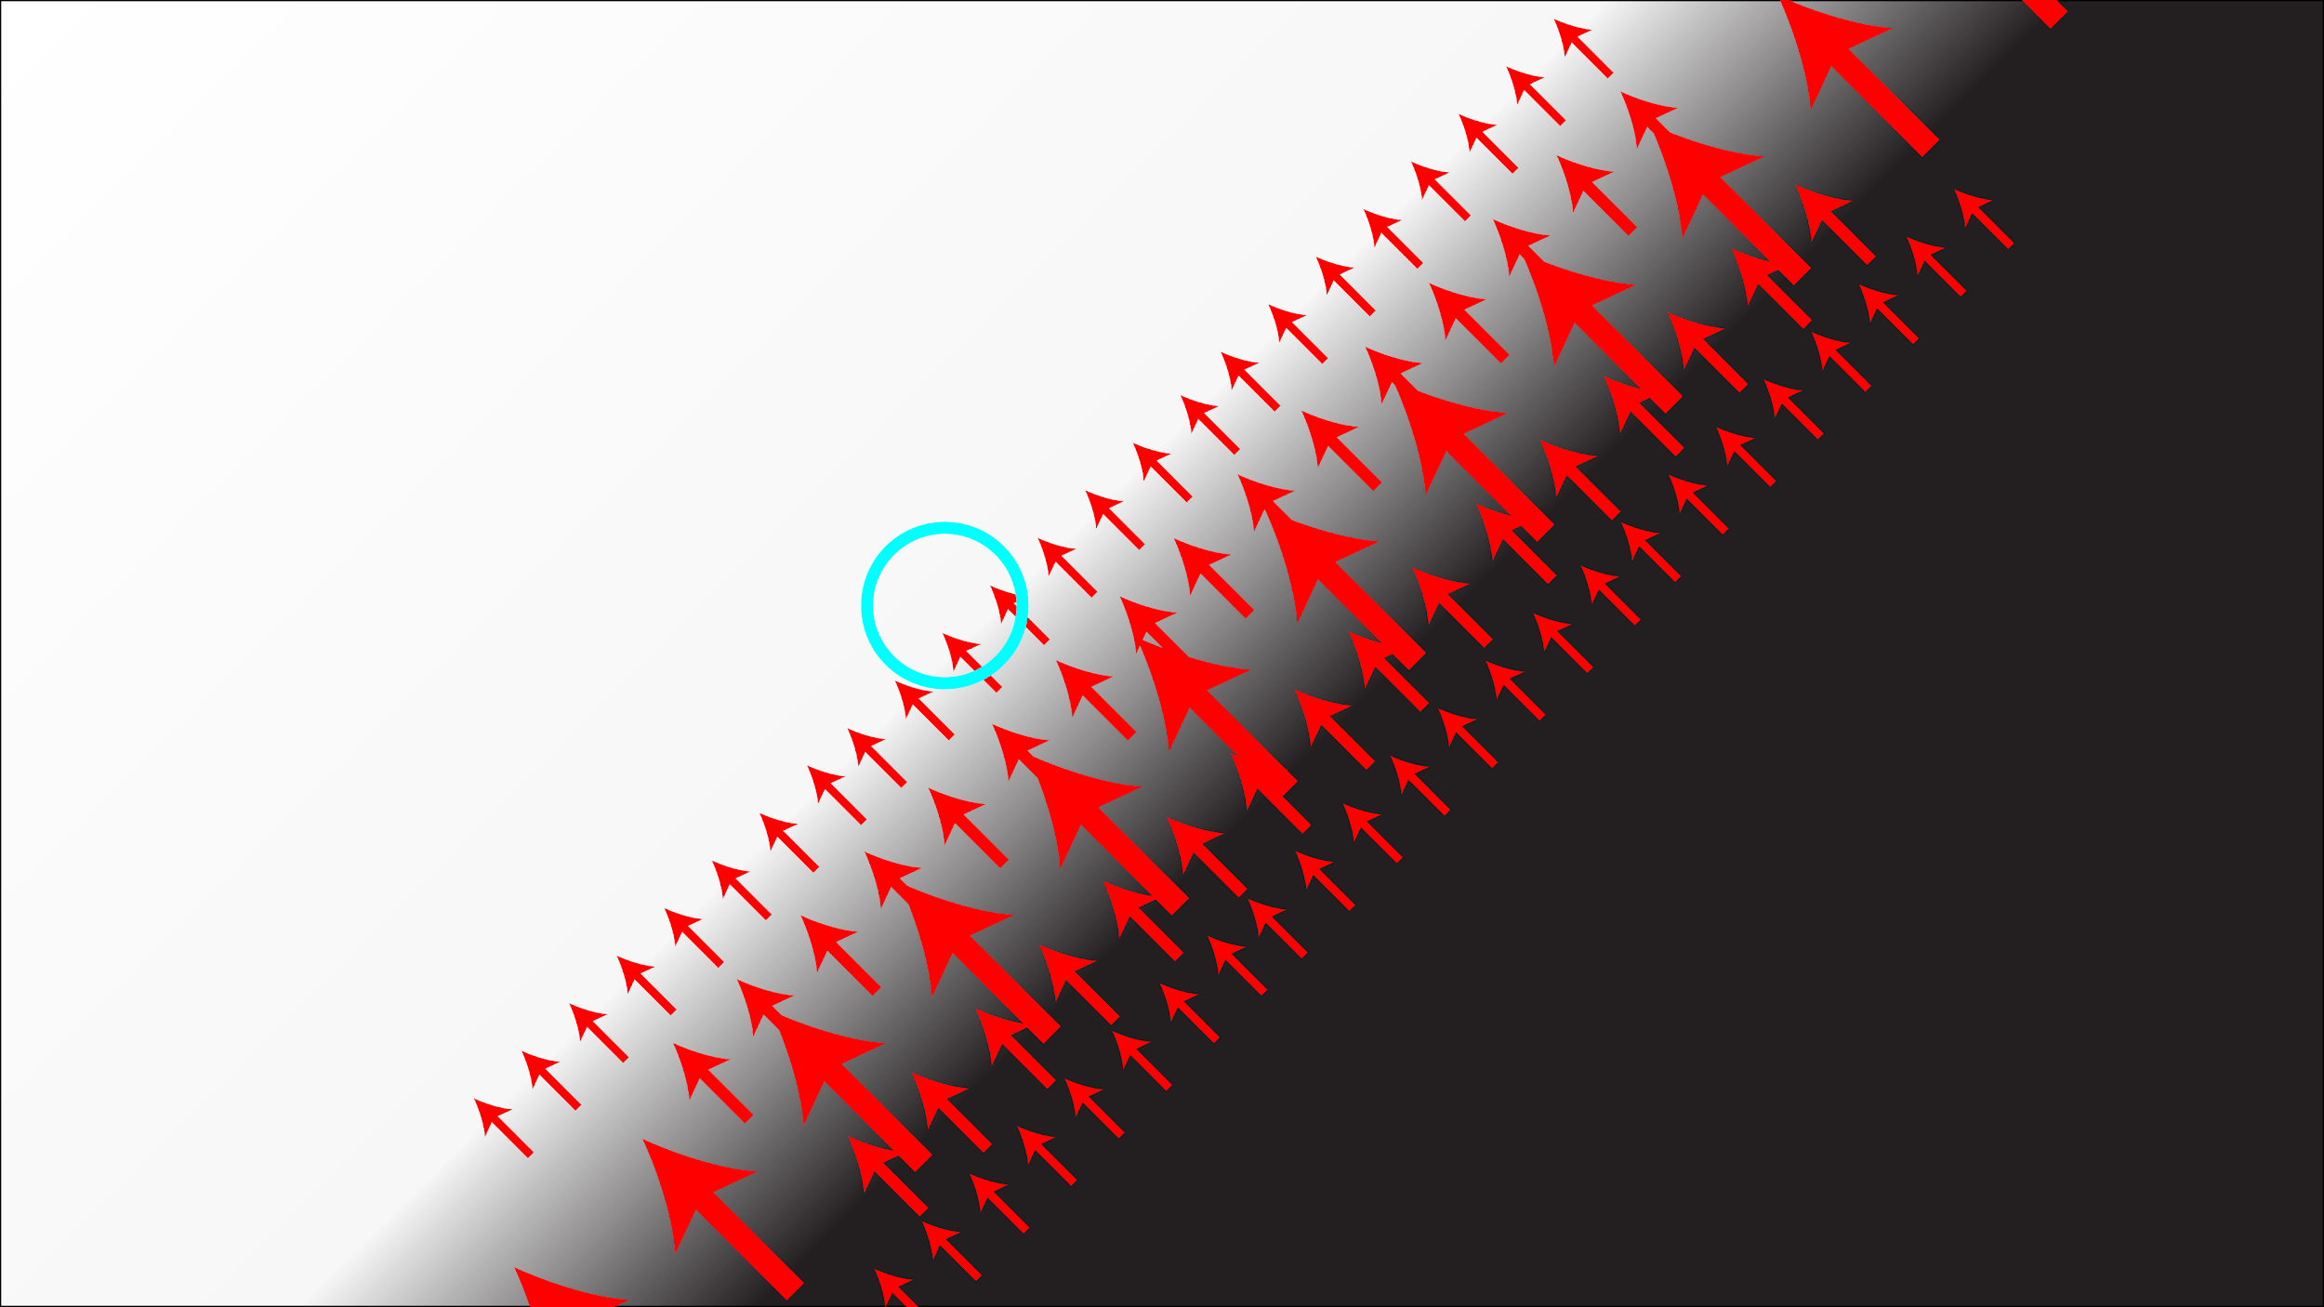

Slide 52
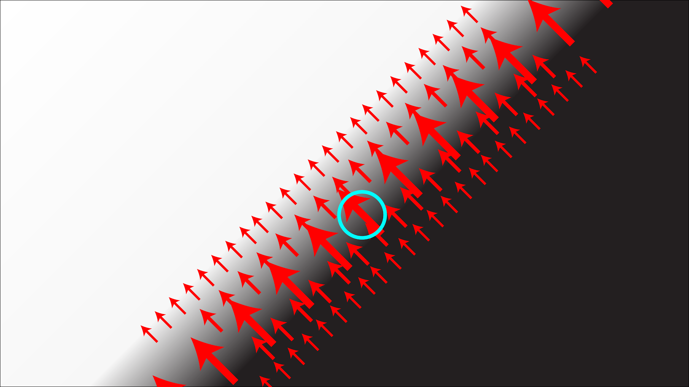

Slide 53
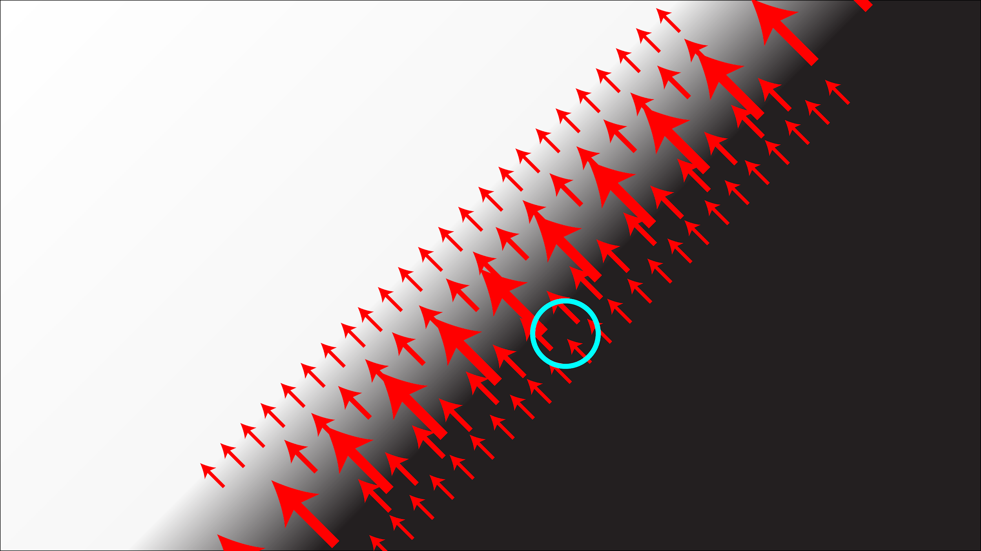

Slide 54
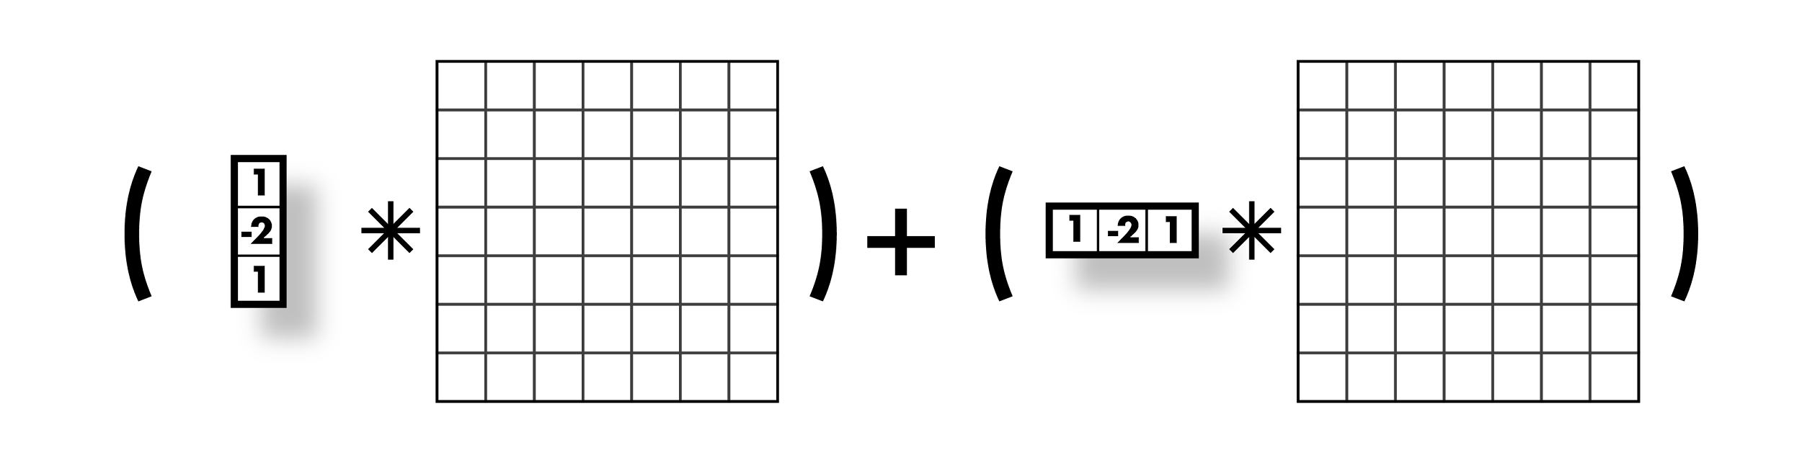
Laplacians
Laplacian:

Slide 55
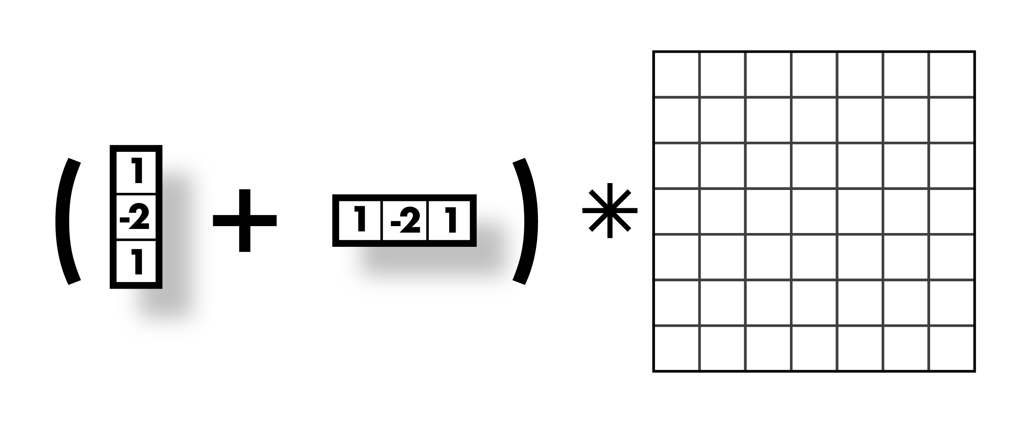
Laplacians
Laplacian:

Slide 56

Laplacians
Laplacian:

Slide 57

Laplacians
Laplacian:

Slide 58
Laplacians
Laplacian:
Negative Laplacian, -4 in middle
Positive Laplacian --->

Slide 59

Laplacians also sensitive to noise
Again, use gaussian smoothing
Can just use one kernel since convs commute
Laplacian of Gaussian, LoG
Can get good approx. with 5x5 - 9x9 kernels

Slide 60
Another edge detector:
Image is a function:
Has high frequency and low frequency components
Think in terms of fourier transform
Edges are high frequency changes
Maybe we want to find edges of a specific size (i.e. specific frequency)

Slide 61
Difference of Gaussian (DoG)
Gaussian is a low pass filter
Strongly reduce components with frequency f < σ
(g*I) low frequency components
I - (g*I) high frequency components
g(σ1)*I - g(σ2)*I
Components in between these frequencies
g(σ1)*I - g(σ2)*I = [g(σ1) - g(σ2)]*I

Slide 62



Difference of Gaussian (DoG)
g(σ1)*I - g(σ2)*I = [g(σ1) - g(σ2)]*I
σ = 2
σ = 1
=

Slide 63
Difference of Gaussian (DoG)
g(σ1)*I - g(σ2)*I = [g(σ1) - g(σ2)]*I
This looks a lot like our LoG!
(not actually the same but similar)

Slide 64

DoG (1 - 0)

Slide 65

DoG (2 - 1)

Slide 66

DoG (3 - 2)

Slide 67

DoG (4 - 3)

Slide 68
Another approach: gradient magnitude
Don’t need 2nd derivatives
Just use magnitude of gradient

Slide 69

Another approach: gradient magnitude
Don’t need 2nd derivatives
Just use magnitude of gradient
Are we done? No!

Slide 70
Another approach: gradient magnitude
Don’t need 2nd derivatives
Just use magnitude of gradient
Are we done? No!

Slide 71

What we really want: line drawing

Slide 72
Canny Edge Detection
http://bigwww.epfl.ch/demo/ip/demos/edgeDetector/
Your first image processing pipeline!
Old-school CV is all about pipelines
Algorithm:
Smooth image (only want “real” edges, not noise)
Calculate gradient direction and magnitude
Non-maximum suppression perpendicular to edge
Threshold into strong, weak, no edge
Connect together components

Slide 73


Smooth image
http://bigwww.epfl.ch/demo/ip/demos/edgeDetector/
You know how to do this, gaussians!

Slide 74

Gradient magnitude and direction
http://bigwww.epfl.ch/demo/ip/demos/edgeDetector/
Sobel filter

Slide 75
Non-maximum suppression
http://bigwww.epfl.ch/demo/ip/demos/edgeDetector/
Want single pixel edges, not thick blurry lines
Need to check nearby pixels
See if response is highest

Slide 76

Non-maximum suppression

Slide 77

Non-maximum suppression

Slide 78

Non-maximum suppression

Slide 79

Non-maximum suppression

Slide 80

Non-maximum suppression

Slide 81

Non-maximum suppression

Slide 82

Non-maximum suppression

Slide 83

Non-maximum suppression
http://bigwww.epfl.ch/demo/ip/demos/edgeDetector/

Slide 84
Threshold edges
http://bigwww.epfl.ch/demo/ip/demos/edgeDetector/
Still some noise
Only want strong edges
2 thresholds, 3 cases
R > T: strong edge
R < T but R > t: weak edge
R < t: no edge
Why two thresholds?

Slide 85
Connect ‘em up!
http://bigwww.epfl.ch/demo/ip/demos/edgeDetector/
Strong edges are edges!
Weak edges are edges iff they connect to strong
Look in some neighborhood (usually 8 closest)

Slide 86
Canny Edge Detection
http://bigwww.epfl.ch/demo/ip/demos/edgeDetector/
Your first image processing pipeline!
Old-school CV is all about pipelines
Algorithm:
Smooth image (only want “real” edges, not noise)
Calculate gradient direction and magnitude
Non-maximum suppression perpendicular to edge
Threshold into strong, weak, no edge
Connect together components
Tunable: Sigma, thresholds

Slide 87
Canny Edge Detection
http://bigwww.epfl.ch/demo/ip/demos/edgeDetector/

Slide 88
What else is there?

Slide 89
So what can we do with these convolutions anyway?
Blurring
Sharpening
Edges
Features
Derivatives
Super-resolution
Classification
Detection
Image captioning
...

Slide 90





Features!
Highly descriptive local regions
Ways to describe those regions
Useful for:
Matching
Recognition
Detection

Slide 91
What makes a good feature?
Want to find patches in image that are useful or have some meaning
For objects, want a patch that is common to that object but not in general
For panorama stitching, want patches that we can find easily in another image of same place
Good features are unique!
Can find the “same” feature easily
Not mistaken for “different” features

Slide 92
How close are two patches?
Sum squared difference
Images I, J
Σ_{x,y} (I(x,y) - J(x,y))²

Slide 93


How can we find unique patches?
Say we are stitching a panorama
Want patches in image to match to other image
Need to only match one spot

Slide 94

How can we find unique patches?
Sky: bad
Very little variation
Could match any other sky

Slide 95
How can we find unique patches?
Sky: bad
Very little variation
Could match any other sky
Edge: ok
Variation in one direction
Could match other patches along same edge

Slide 96
How can we find unique patches?
Sky: bad
Very little variation
Could match any other sky
Edge: ok
Variation in one direction
Could match other patches along same edge
Corners: good!
Only one alignment matches

Slide 97
How can we find unique patches?
Want a patch that is unique in the image
Can calculate distance between patch and every other patch, lot of computation
*

Slide 98
How can we find unique patches?
Want a patch that is unique in the image
Can calculate distance between patch and every other patch, lot of computation
Instead, we could think about auto-correlation:
How well does image match shifted version of itself?
Σ_{d}Σ_{x,y} (I(x,y) - I(x+d_{x},y+d_{y}))²
Measure of self-difference (how am I not myself?)

Slide 99

Self-difference
Sky: low everywhere

Slide 100

Self-difference
Edge: low along edge

Slide 101

Self-difference
Corner: mostly high

Slide 102




Self-difference
Sky: low everywhere
Edge: low along edge
Corner: mostly high

Slide 103
Self-difference is still expensive
Σ_{d}Σ_{x,y} (I(x,y) - I(x+d_{x},y+d_{y}))²
Lots of summing
Need an approximation
If you want the mathy details, Szeliski pg 212

Slide 104
Approximate self-difference
Look at nearby gradients I_{x} and I_{y}
If gradients are mostly zero, not a lot going on
Low self-difference
If gradients are mostly in one direction, edge
Still low self-difference
If gradients are in twoish directions, corner!
High self-difference, good patch!

Slide 105

Approximate self-difference
How do we tell what’s going on with gradients?
Eigen vectors/values!
Need structure matrix for patch, just a weighted sum of nearby gradient information
Not as complex as it looks, weighted sum of gradients near pixel

Slide 106
Structure matrix
Weighted sum of gradient information
| Σ_{i}w_{i}I_{x}(i)I_{x}(i) Σ_{i}w_{i}I_{x}(i)I_{y}(i) |
| Σ_{i}w_{i}I_{x}(i)I_{y}(i) Σ_{i}w_{i}I_{y}(i)I_{y}(i) |
Can use Gaussian weighting (so many gaussians)
Eigen vectors/values of this matrix summarize the distribution of the gradients nearby
λ₁ and λ₂ are eigenvalues
λ₁ and λ₂ both small: no gradient
λ₁ >> λ₂: gradient in one direction
λ₁ and λ₂ similar: multiple gradient directions, corner

Slide 107
Estimating smallest eigen value
A few methods:
det(S) = λ₁*λ₂
trace(S) = λ₁+λ₂
det(S) - α trace(S)² = λ₁λ₂ - α(λ₁+λ₂)²
det(S) / trace(S) = λ₁λ₂/(λ₁+λ₂)
If these estimates are large, λ₂ is large

Slide 108
Harris Corner Detector
Calculate derivatives I_{x} and I_{y}
Calculate 3 measures I_{x}I_{x}, I_{y}I_{y}, I_{x}I_{y}
Calculate weighted sums
Want a weighted sum of nearby pixels, guess what this is?
Gaussian!
Estimate response based on smallest eigen value
Non-max suppression (just like canny)

Slide 109


